Slide 1
NE 763: Advanced Reactor Materials
Fall 2026
Dr. Benjamin Beeler

Slide 2
Last Time
Why do we need advanced materials for cladding?
  Austenitic steels undergo excessive void swelling in fast reactor conditions
Why F/M steels?
  have good mechanical properties, are cheap, and their microstructure can be tailored through composition and fabrication
Microstructure of F/M steels?
  ferrite grains with martensite laths; M23C6 and monocarbide precipitates are prevalent both along grain boundaries and within the grains; M2X metallic precipitates form and can be converted to Laves phases
Tailoring of alloying elements has allowed for improved creep strength
  impacts precipitation and solid solution strengthening

Slide 3
Void Swelling
Void swelling depends crucially on the structure of the matrix lattice, in which irradiation produces the excess defects
There are several reasons why the swelling resistance in ferritic steels is better than austenitic steels
First, the relaxation volume for interstitials is smaller in ferrite than in austenite
Thus, for a given interstitial, the strain field is smaller in ferrite, and the bias for interstitials to sink at dislocations is lower
This promotes recombination
Second, the migration barrier of vacancies in ferrite is much lower than in austenite (0.55 eV to 1.4 eV)
Since vacancies are more mobile in ferrite, recombination is more likely with the dispersed isolated interstitials
Third, excess vacancies can be trapped at carbide particles, of which there is a high number density, as the C-vacancy binding energy in ferrite is twice that in austenite

Slide 4
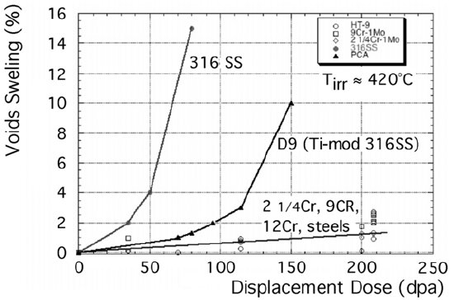
Void Swelling
Fourth, the way dislocations and solutes interact in ferrite makes them strong sinks, generating strain fields that attract vacancies and provide a high sink density
Finally, the complex microstructure of martensite laths and a ferrite matrix inherently produces a very high density of sinks, with some arguing the fundamental microstructure of F-M steels governs the improved swelling behavior
Some combination of all of these factors likely contribute

Slide 5
Ferritic/Martensitic Steels Summary
Austenitic steels undergo excessive void swelling in fast reactor conditions
F/M steels have good mechanical properties, are cheap, and their microstructure can be tailored through composition and fabrication
M23C6 and monocarbide precipitate are prevalent both along grain boundaries and within the grains
Tailoring of alloying elements has allowed for improved creep strength
Embrittlement is caused by segregation of elements to lath boundaries and evolution of precipitates
DBTT shift is minimized for 9Cr steels
F/M steels swell very little, one of the key features making them suitable for application

Slide 6
Radiation-resistant austenitics
Notes:
Positioning: Lec 18 opened with why 304/316 fail (void swelling). This block covers the other response: fixing the austenitics instead of replacing them with F/M steels.

Slide 7
Where Advanced Austenitics Still Matter
15-15Ti-type steels are the planned first-core cladding for many Gen IV concepts
Concept | Coolant | Class | Planned / reference cladding
ALFRED (EU LFR) | Pb | Austenitic | 15-15Ti (AIM1), 20% CW; Al₂O₃ coating for later stages
MYRRHA (BE, ADS) | LBE | Austenitic | 15-15Ti (DIN 1.4970), 24% CW
CFR-600 (China) | Na | Austenitic | CN15-15Ti (316Ti and ODS also in development)
ALLEGRO (EU GFR) | He | Austenitic | 15-15Ti for first core; SiC/SiC later
PFBR (India) | Na | Austenitic | D9
BN-600/800 (Russia) | Na | Austenitic | ChS-68
Natrium (US) | Na | F/M | HT9 (U-10Zr metallic fuel)
BREST-OD-300 (Russia) | Pb | F/M | EP823 (12Cr-Si)
Sources: ENEA/Bassini, IAEA TM 2019 (ALFRED); SCK CEN (MYRRHA); CIAE, IAEA FR22 (CFR-600); IAEA FR22 (ALLEGRO); Séran & Le Flem (2017) Table 8.1 (PFBR, BN); PNNL 2024 (Natrium); IPPE 2018 (BREST)
Notes:
Point of the slide: F/M (HT9) is the planned cladding for US metallic-fuel SFRs and for Russia's BREST LFR, but 15-15Ti-type austenitics remain the near-term choice for the European LFR and ADS designs, China's CFR-600 and the ALLEGRO GFR first core; D9 for India. ALFRED: Bassini et al., ENEA, IAEA Technical Meeting on Structural Materials for HLM-cooled FRs (2019), https://conferences.iaea.org/event/205/contributions/15856/attachments/8279/10927/ID-10-BASSINI-ENEA-Bassini_IAEA.pdf ; 15-15Ti 20% CW (AIM1) cladding and FA structures to ~100 dpa, Al2O3 by PLD for later, hotter stages. MYRRHA: 24% CW 1515Ti (1.4970) is the SCK CEN reference cladding (Materials at High Temperatures 2024, doi 10.1080/09603409.2024.2321007). CFR-600: CIAE keynote, IAEA FR22 (2022) lists 316Ti, CN-1515 and ODS cladding candidates with CN-FMS ducts; J. Nucl. Sci. Technol. (2018) doi 10.1080/00223131.2018.1531076 describes CN15-15Ti (adds Co, V). Final cladding choice not confirmed in what I found. ALLEGRO: IAEA FR22 contribution 18789: first core MOX or UOX in 15-15Ti; second core carbide in SiC/SiC. Natrium: Wray & Geelhood, PNNL report for NRC (2024): sodium-bonded U-10Zr clad in HT9. BREST-OD-300: IPPE (2018) presentation; EP823 qualified for cladding and wrappers; 12Cr-1SiMoWVNb (NUCET 2024). These are planning documents; designs can change.

Slide 8
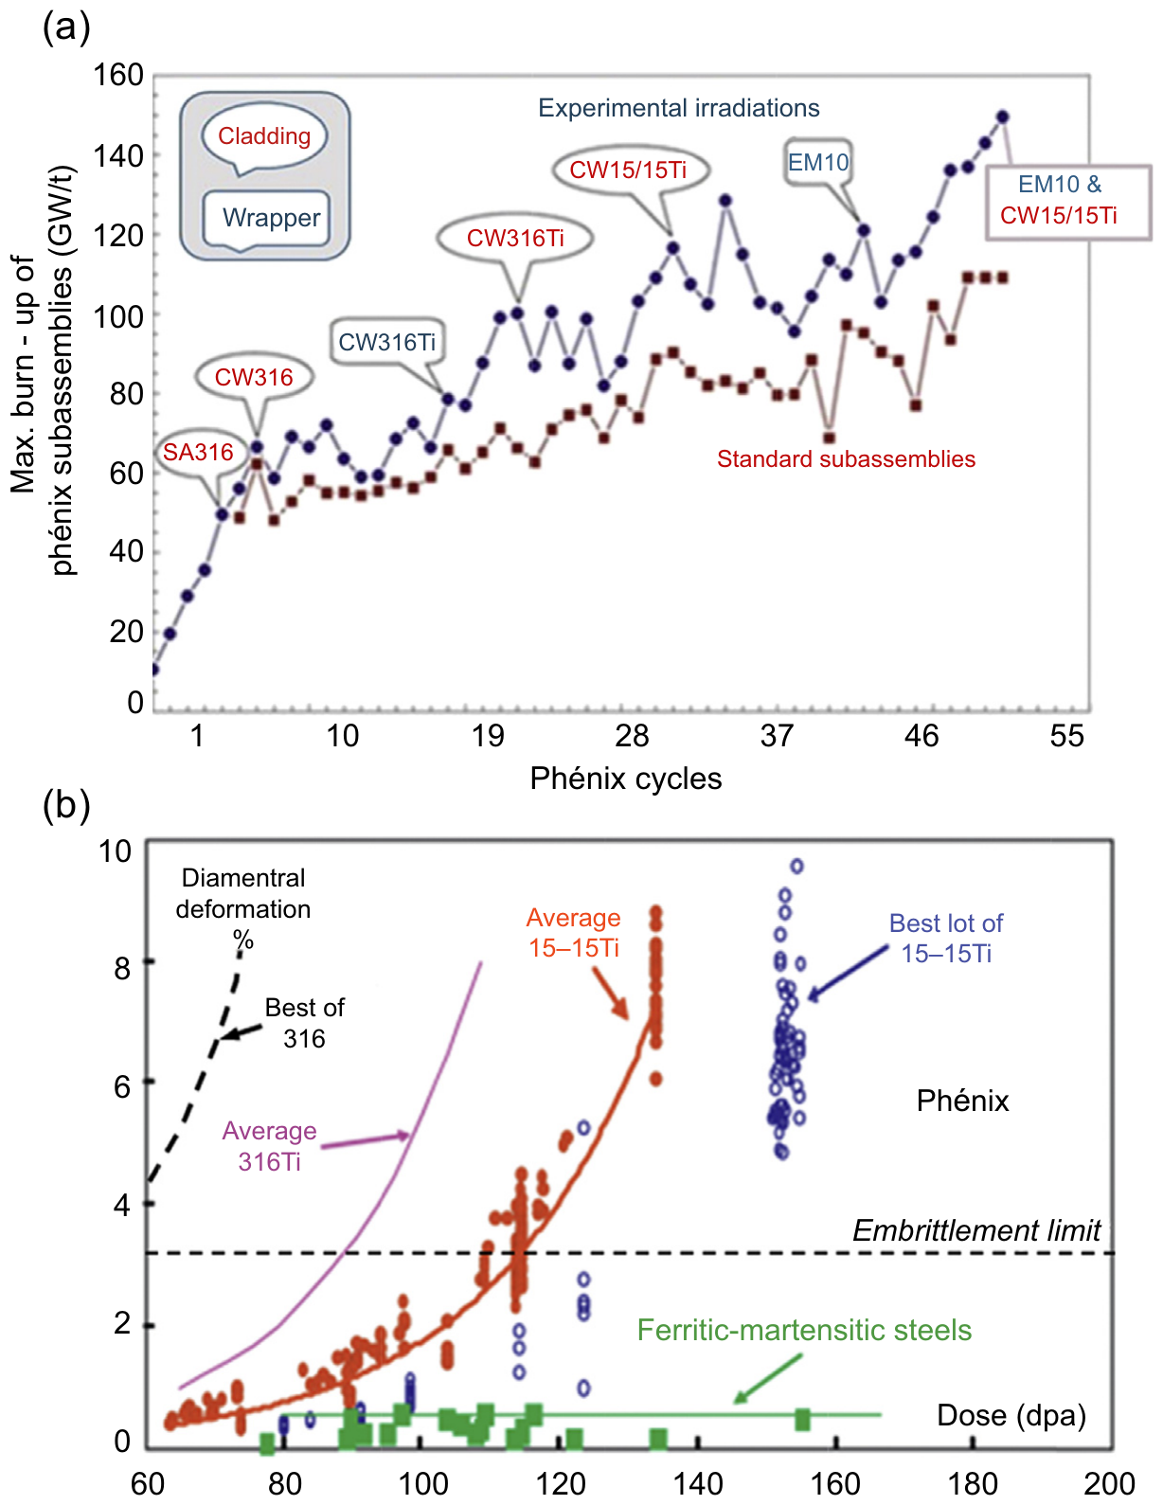
Why Austenitics, and Why Not
Strengths
  FCC: no ductile-to-brittle transition
  Stronger in thermal creep than F/M above ~550C
  Largest fuel-pin database: 15/15Ti to 155 dpa in Phénix
  ≥15% Cr: compatible with nitric-acid reprocessing
Limits
  Void swelling: incubation, then ~1%/dpa
  Ni: He generation, and dissolution in Pb/LBE
  ~50% higher thermal expansion, lower conductivity than F/M
Key question: how far can alloying push the incubation dose?
(a) Phénix burnup as clad/wrapper materials changed; (b) diametral deformation vs. dose. Séran & Le Flem, Structural Materials for Gen IV Reactors (2017), Fig. 8.1
Notes:
Séran & Le Flem (2017), Sections 8.2-8.3. Fig. 8.1(a): maximum Phénix subassembly burnup vs. reactor cycle as cladding moved SA316 -> CW316 -> CW316Ti -> CW15/15Ti and wrappers moved to EM10. Fig. 8.1(b): diametral deformation vs. dose for Phénix grades and F/M wrappers; note the embrittlement limit. Conventional F/M steels are limited to roughly 550 C by thermal creep (Henry & Maloy, Ch. 9), which is why austenitics keep the higher-temperature cladding role unless ODS or advanced F/M steels are used. Reprocessing: Fig. 8.4, Fe dissolution in boiling HNO3 falls with Cr content. Ni dissolution in Pb/LBE: see the LFR lecture; this is why ALFRED plans alumina coatings.

Slide 9
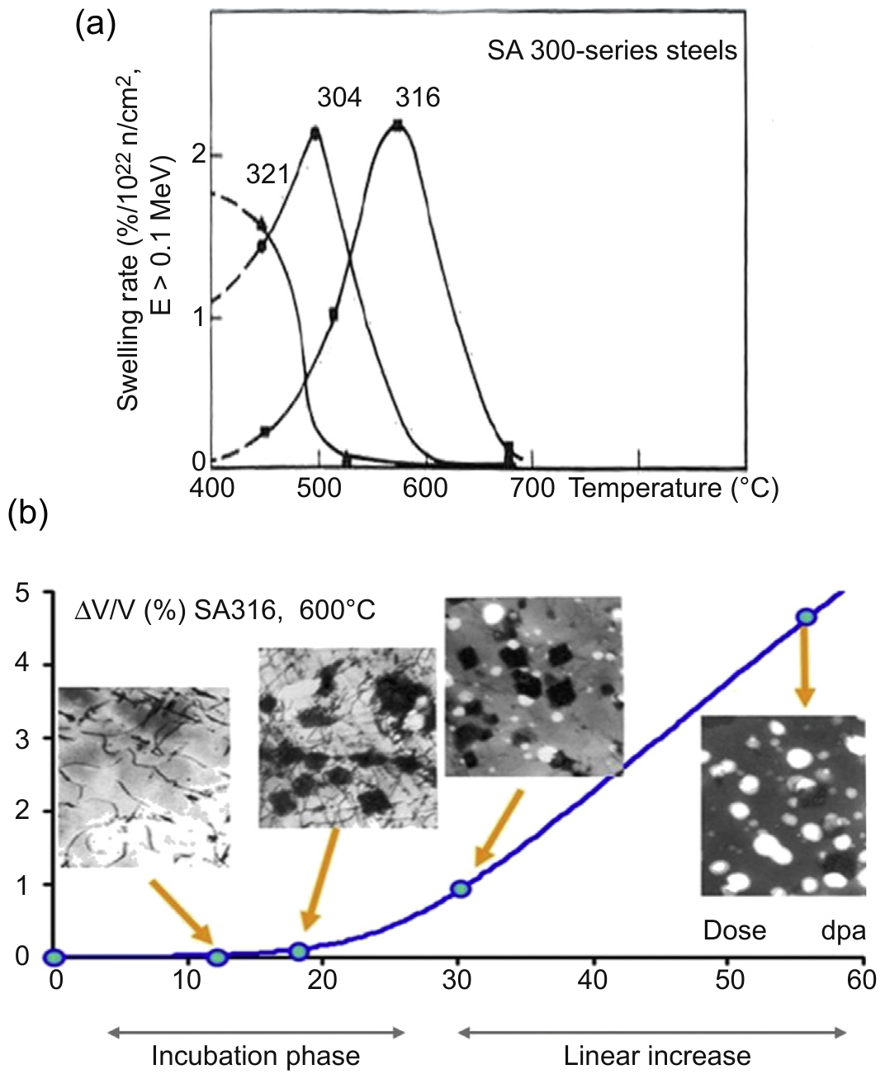
Swelling vs. Temperature and Dose
Swelling peaks between ~0.3 and 0.5 Tm
  Void nucleation falls with T; void growth rises with T
  For core steels the peak is at 400–700 °C: the subassembly operating range
At fixed T: incubation, then linear growth
  During incubation, small voids nucleate with little macroscopic swelling
Steady-state rate (~1%/dpa) is hard to change
  So alloy design targets the incubation dose
Higher dose rate shifts the peak to higher T and lengthens incubation
(a) Swelling rate vs. T, SA 300-series in EBR-II; (b) SA316 at 600 °C in Phénix. Séran & Le Flem, Structural Materials for Gen IV Reactors (2017), Fig. 8.10
Notes:
Section 8.5.2.1. Below ~0.3 Tm, recombination dominates (loops, hardening, no voids). Above ~0.5 Tm, defects reach sinks too fast for vacancy supersaturation. Fig. 8.10(b) TEM insets show the dislocation structure being replaced by coarse voids and precipitates in the linear regime. The ~1%/dpa steady-state rule of thumb: Chung, NUREG/CR-6897 [6]; ion data on 15-15Ti to 400 dpa still near 1%/dpa [8].

Slide 10
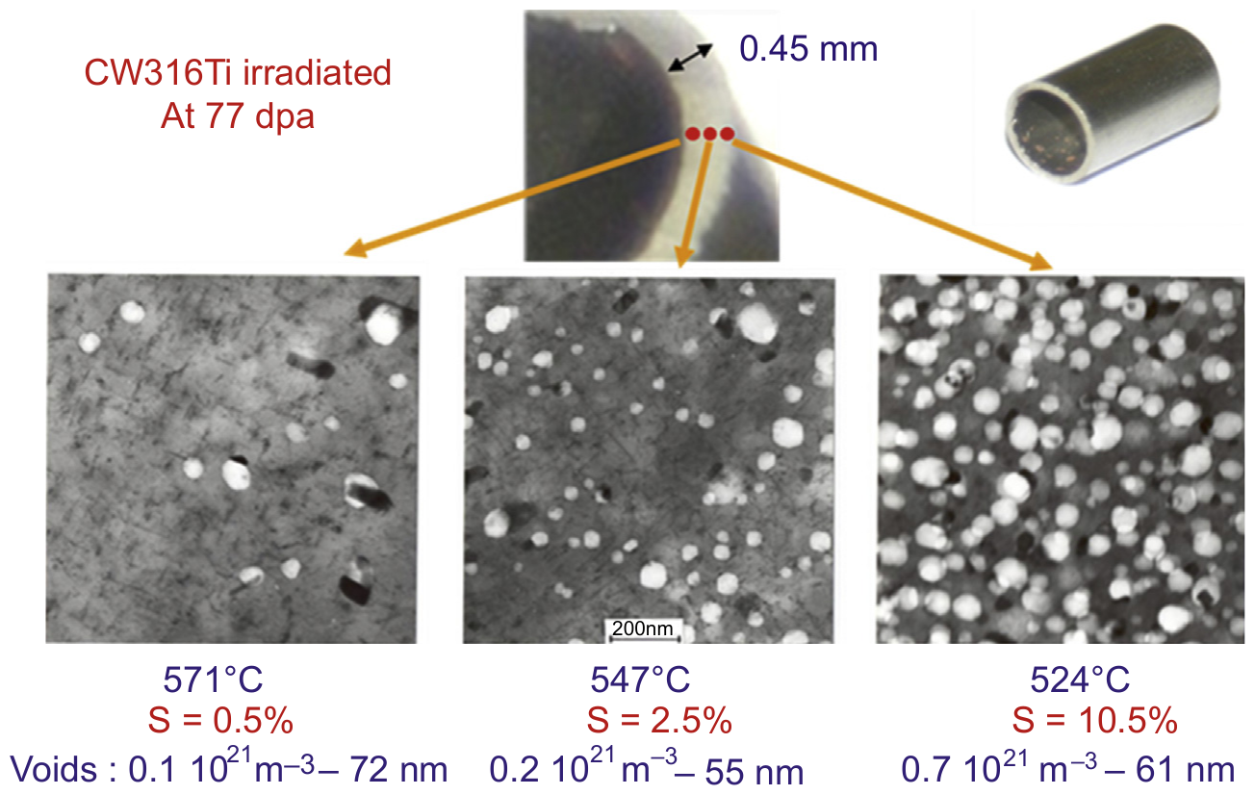
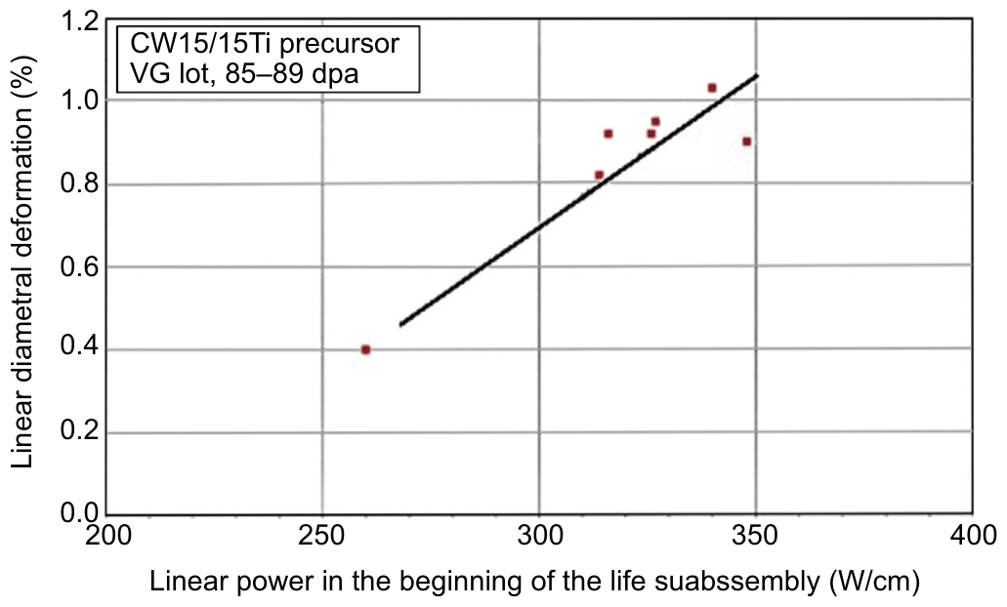
Swelling Gradients and Irradiation History
A fuel clad is a heat exchanger: the radial temperature gradient creates a swelling gradient
  CW316Ti, 77 dpa: 0.5% at 571 °C vs. 10.5% at 524 °C across a 0.45 mm wall
Within one bundle, swelling varied ~4× at the same lot, dose and history
  Most of the scatter tracks the local gradient
  Wrappers (no strong gradient) swell less than pins of the same steel
Early life is "memorized": high linear power at the start gives more deformation at the same final dose
Top: TEM at three depths of a 316Ti pin, 77 dpa (Fig. 8.11). Bottom: 15/15Ti deformation vs. early-life linear power (Fig. 8.12). Séran & Le Flem, Structural Materials for Gen IV Reactors (2017)
Notes:
Section 8.5.2.2. Fig. 8.11: TEM at three depths of one Phénix 316Ti pin, same level, same 77 dpa. Fig. 8.12: 15/15Ti precursor (VG lot) pins at 85-89 dpa from different subassemblies; higher beginning-of-life linear power = more deformation. The authors note that a 'cold start, hot finish' history can exceed the swelling at the average temperature because voids nucleated early keep growing.

Slide 11
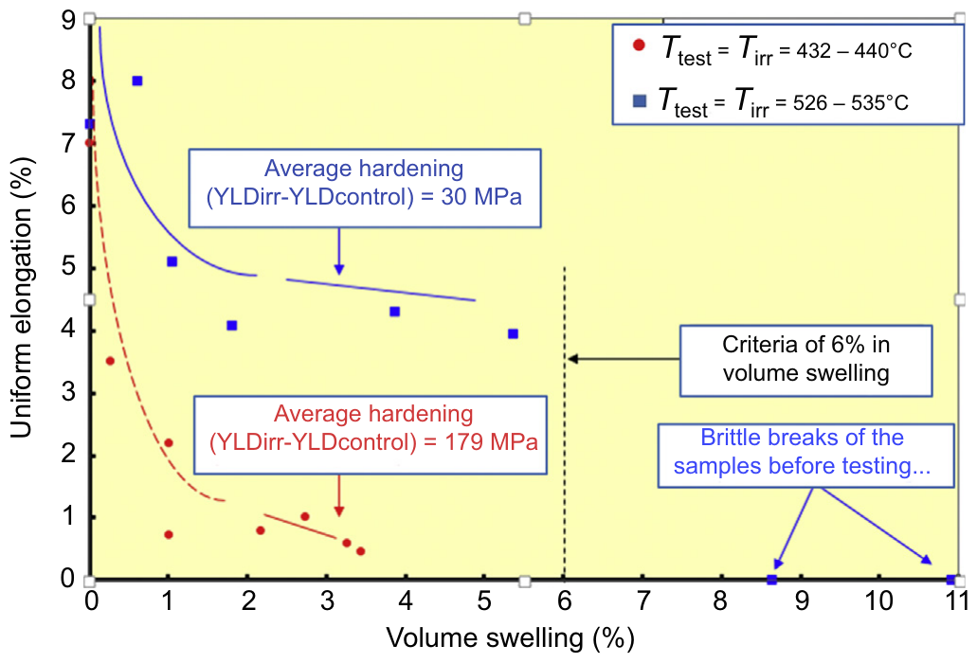
Swelling-Induced Embrittlement
Irradiation hardens below ~500 °C and softens above; both saturate with dose
Ductility falls with swelling; fracture shifts from dimples to channel fracture
Above ~6% volume swelling, cavity porosity drives severe embrittlement
  Near-zero ductility above ~10%
  Phénix limit: 6% volume ≈ 3% linear strain (incl. irradiation creep)
Worse at low irradiation T, where hardening is high
Irradiation creep is not treated as damaging: it relaxes stress
Uniform elongation of Phénix 15/15Ti pins vs. local volume swelling. Séran & Le Flem, Structural Materials for Gen IV Reactors (2017), Fig. 8.9
Notes:
Sections 8.2.2, 8.4 and 8.5.1. Fig. 8.9: uniform elongation of Phénix 15/15Ti pins vs. local swelling; red = irradiated at 432-440 C (hardening +179 MPa), blue = 526-535 C (+30 MPa). The 6% criterion came from CEA post-irradiation work on 316Ti clads and wrappers; above it, fracture toughness collapses (the F/M chapter cites <20 MPa m^1/2 for austenitics above 6%).

Slide 12
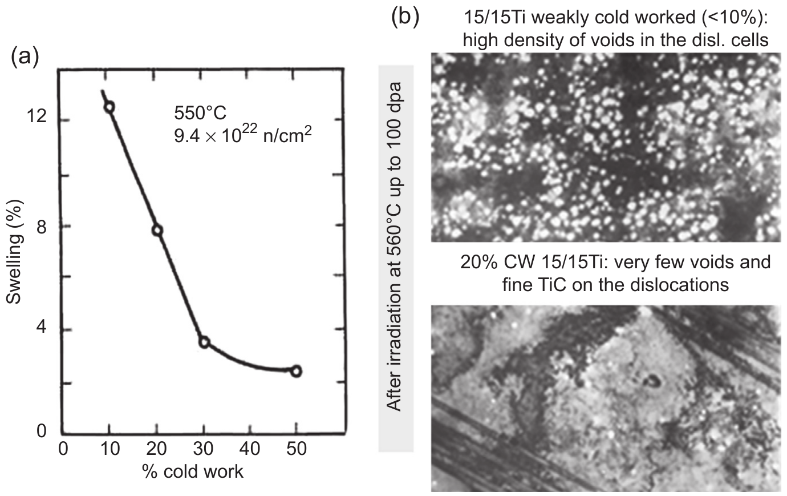
Cold Work
Final 20–25% cold work is standard for clad and wrapper tubes
Benefit peaks at ~20–30% CW
  Below ~10%: coarse dislocation cells recover and fill with voids
  Above ~30%: little extra benefit; risk of recrystallization under irradiation
Under irradiation, CW and SA dislocation densities converge
Without Ti, cold work is not stable above ~550 °C (next slides)
Cold work buys dose, not immunity
(a) Swelling vs. % cold work; (b) 15/15Ti after 560 °C to 100 dpa, <10% CW (top) vs. 20% CW (bottom). Séran & Le Flem, Structural Materials for Gen IV Reactors (2017), Fig. 8.19
Notes:
Section 8.5.3.4. Fig. 8.19(a) is Japanese data (550 C, 9.4e22 n/cm2); (b) is CEA TEM after 560 C to 100 dpa. Dislocation density convergence: Fig. 8.5(a), CW and SA 316 in EBR-II at 500 C reach the same steady-state network density. The key difference is that only the pre-existing CW network gets decorated by Ti (Cottrell atmospheres), which is why stabilized CW steels outperform stabilized SA steels.

Slide 13
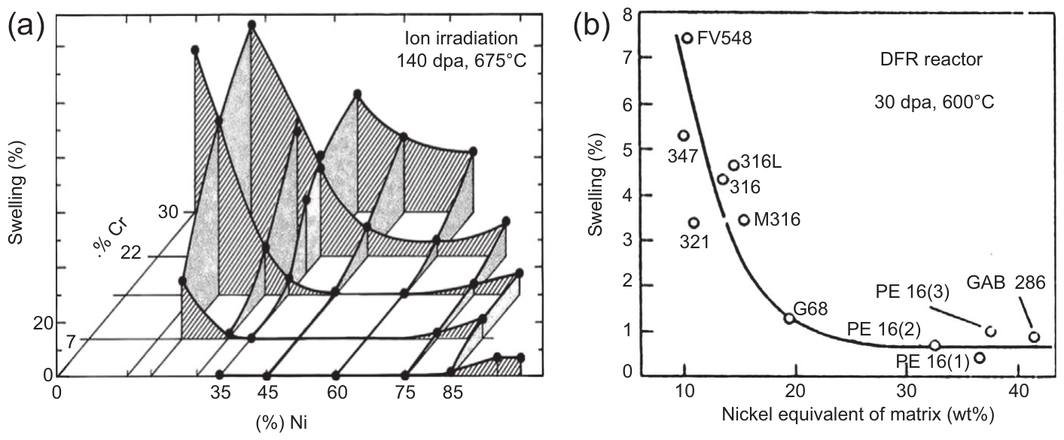
Major Elements: Ni and Cr
Swelling resistance tracks austenite stability
Ion data (Fe-Cr-Ni): Ni helps from 15% to 60%; Cr hurts from 7% to 30%
Neutron data (DFR, 600 °C): swelling falls as matrix Ni equivalent rises
  Ni_eq = Ni + Co + 0.5Mn + 30C + 0.3Cu + 25N
This drove 304/316 → 15/15Ti and D9
The cost of Ni: more He from transmutation, and high-Ni precipitation-hardened alloys (PE16, Inconel 706) lost ductility
(a) Ni and Cr effects in Fe-Ni-Cr, 5 MeV ions; (b) swelling vs. Ni equivalent, industrial alloys in DFR. Séran & Le Flem, Structural Materials for Gen IV Reactors (2017), Fig. 8.13
Notes:
Section 8.5.3.1. Johnston's ternary ion data (5 MeV, 140 dpa, 675 C) and Watkin's DFR data. PE16 (43.5% Ni) was the British reference; CEA found unacceptable post-irradiation ductility in PE16, as the US did for Inconel 706 (Fig. 8.20b). Ni helium generation: see the Ni alloys material in Lec 20.

Slide 14
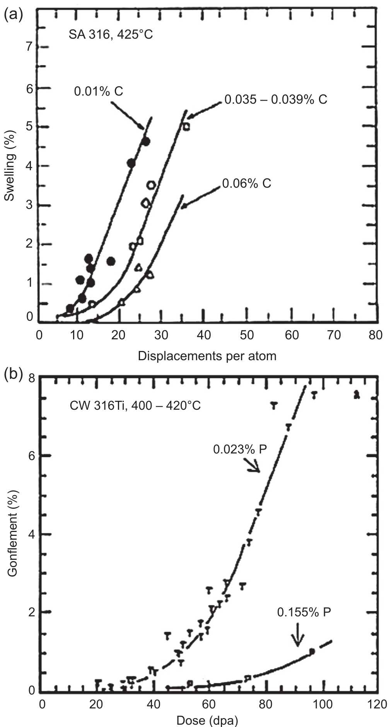
Minor Elements: C, Si, P
Below ~550 °C, C, Si, P and Ti raise the incubation dose
  Only while they stay in solid solution
  Si benefit did not saturate up to ~0.9 wt% (450 °C)
P: binds vacancies; forms fine phosphides that pin CW dislocations
Above ~550 °C, excess C and Si destabilize the alloy, so specs set maximums too
Not all additions help
  V stabilizes a high cavity density; Mo >2% and high Mn are harmful
  N and B help, but transmute to He
(a) Carbon in SA 316, 425 °C, DFR; (b) phosphorus in CW 316Ti, ~410 °C, Phénix. Séran & Le Flem, Structural Materials for Gen IV Reactors (2017), Fig. 8.14
Other source: [12]
Notes:
Sections 8.5.3.2-8.5.3.3. Fig. 8.14(a): SA 316 at 425 C in DFR, higher C delays swelling. (b): CW 316Ti at ~410 C in Phénix, 0.155% P vs. 0.023% P. Si result is from the CEA CASTOR capsule (71 dpa, 450 C), Fig. 8.15(a). P can be non-monotonic at low levels (Garner & Mitchell 1992 [12]). V result: Delalande thesis. N and B have among the highest He transmutation cross-sections in a fast spectrum, so nitrides/borides become He sources.

Slide 15
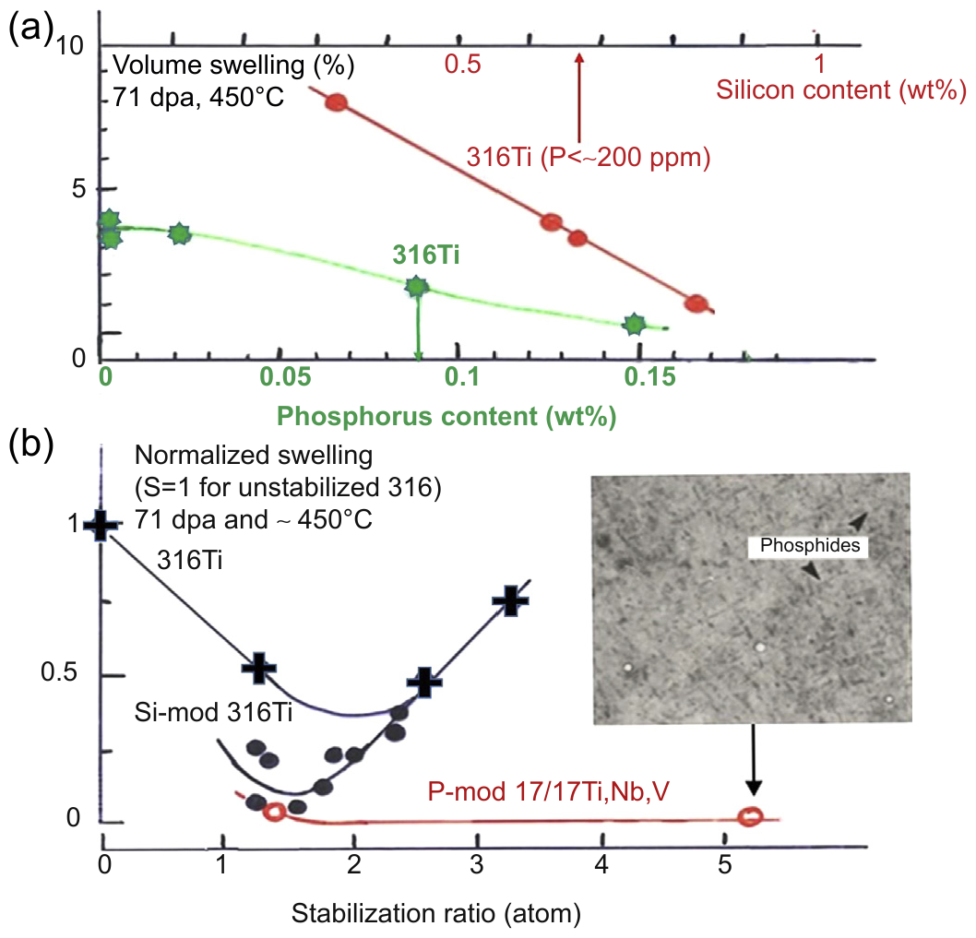
Ti Stabilization
Ti has the largest effect of the stabilizers (Ti, Nb, V)
  With cold work, it suppresses the high-T second swelling peak
Ti decorates CW dislocations: they become neutral sinks and resist recovery
  SA 316Ti swells poorly: irradiation-created dislocations are not decorated
Keep Ti in solution: SR = (Ti+Nb+V)/C ≈ 1
  Too low: little free Ti. Too high: little free C, unstable Ni/Ti/Si phases
P-doped multistabilized 17/17 tolerates high SR: phosphides take Nb and V, leaving Ti
(a) Si and P in CW 316Ti; (b) normalized swelling vs. stabilization ratio. Phénix CASTOR capsule, 71 dpa, ~450 °C. Séran & Le Flem, Structural Materials for Gen IV Reactors (2017), Fig. 8.15
Notes:
Section 8.5.3.2 ('Special role of stabilizing elements'). Mechanism after Weertman and Green: solute-decorated dislocations act as unbiased (neutral) sinks and promote recombination. Fig. 8.15(a): Si (red) and P (green) in CW 316Ti, CASTOR capsule, 71 dpa, 450 C. Fig. 8.15(b): swelling normalized to unstabilized 316 vs. stabilization ratio (atomic); 316 swells about twice as much as most 316Ti. The same 'stable fine features' idea underlies HT-UPS and, in a ferritic matrix, ODS.

Slide 16
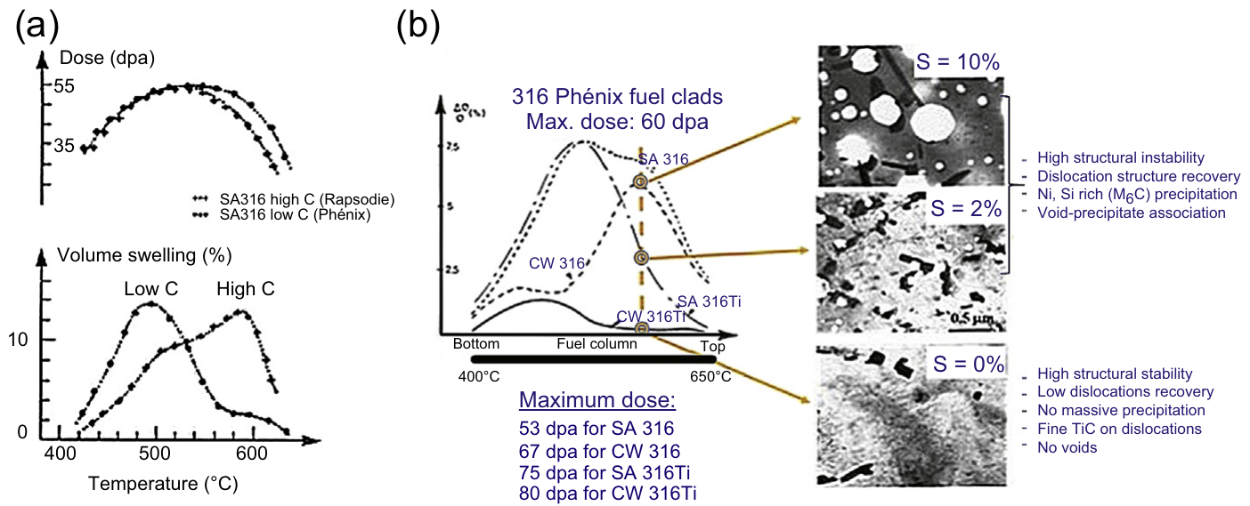
Phase Instability Under Irradiation
Above ~550 °C, high-C/Si grades show a second swelling peak
Coarse Ni-, Si-, C-rich phases form, often attached to voids
  Matrix loses its swelling inhibitors, and swelling accelerates
RIS feeds this: Ni and Si enrich at sinks, Cr depletes
  γ′ (Ni₃Si), G-phase, M₂₃(C,Si)₆ and M₆C form
  ChS-68 in BN-600: swelling onset coincided with G-phase
CW + Ti: fine TiC on dislocations, no voids (bottom inset)
(a) High-C vs. low-C SA316 pins; (b) Phénix 316-family clads: microstructure at 10%, 2% and 0% swelling. Séran & Le Flem, Structural Materials for Gen IV Reactors (2017), Fig. 8.16
Other sources: [9], [14], [15]
Notes:
Section 8.5.3.2. Fig. 8.16(a): two SA316 Phénix/Rapsodie pins at the same maximum dose; the high-C (0.055% C, 0.6% Si) Rapsodie lot shows a pronounced second peak, the low-C (0.034% C, 0.41% Si) Phénix lot does not. Fig. 8.16(b): 316 family clads at ~600 C: S = 10% with Ni/Si-rich M6C and void-precipitate association; S = 0% with fine TiC on dislocations (CW 316Ti). RIS: Allen, Cole, Was, Kenik (2002) [14]. gamma-prime and M23(C,Si)6 in 316: 1978 J. Nucl. Mater. [15]. ChS-68 and G-phase: Porollo, Konobeev, Garner (2009) [9]; segregation to void surfaces can also reduce swelling, so RIS is not purely harmful.

Slide 17
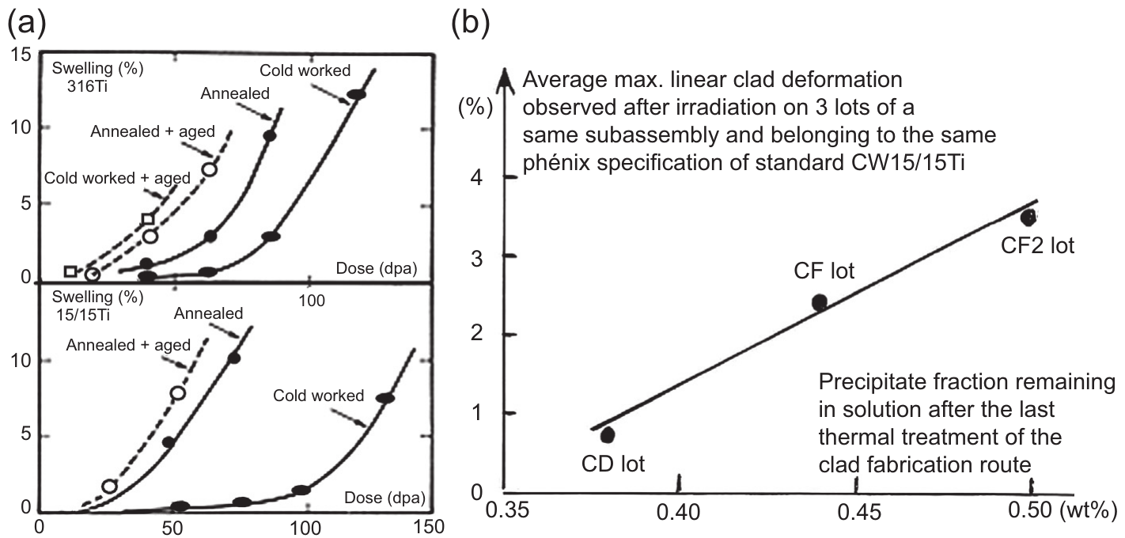
Fabrication Quality Matters
Composition alone does not guarantee swelling resistance: the solutes must be dissolved
A final aging treatment must be avoided
  Thermal MC carbides remove inhibitors before irradiation starts
Three Phénix 15/15Ti lots, same spec, same subassembly
  Deformation scaled with Ti carbonitrides left undissolved
  ~30% more precipitate → ~5× worse swelling
Final step: specified solution anneal (T, time, cooling), then 20–25% CW
(a) Aged vs. unaged Ti-stabilized steels, Rapsodie, 500 °C; (b) clad deformation vs. undissolved precipitate fraction for three lots. Séran & Le Flem, Structural Materials for Gen IV Reactors (2017), Fig. 8.18
Notes:
Section 8.5.3.4. Fig. 8.18(a): Rapsodie, 500 C; SA, SA+CW, SA+aged and SA+CW+aged 316Ti (top) and 15/15Ti (bottom). Fig. 8.18(b): lots CD, CF, CF2 in subassembly BOITIX 5; the x-axis is the precipitate fraction in the unirradiated control measured by selective extraction. CF2 was 'probably badly made'.

Slide 18
Helium Effects
Ni helps against swelling but produces He
  Strongest in thermal or mixed spectra (see Ni alloys)
N and B transmute readily to He in a fast spectrum, so their contents are capped
He promotes swelling at high T; GB bubbles reduce creep ductility
Mitigation: dispersed TiC holds He in the matrix (DIN 1.4970 creep tests)
Design tension: the Ni lever for swelling has a helium cost
Sources: [7], [17]; Séran & Le Flem (2017) §8.5.3.3
Notes:
N and B point: Séran & Le Flem (2017), Section 8.5.3.3 and footnote. He and swelling: Griffiths (2021) [7]. TiC and He embrittlement in DIN 1.4970: Kesternich, Matta, Rothaut (1984) [17]. This connects the Ni-alloy slides in Lec 20 to the austenitic cladding story.

Slide 19
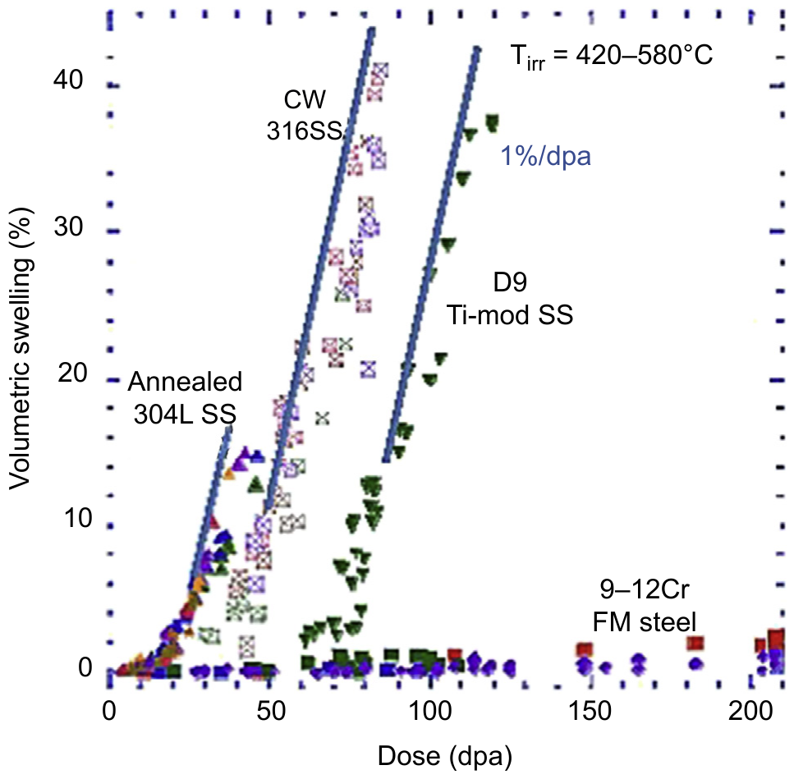
In-Reactor Performance
FFTF, 420–580 °C: CW 316 and D9 both reach ~1%/dpa after incubation
  D9 incubates longer than 316, but shorter than 15/15Ti
Phénix: 15/15Ti to 155 dpa; D4 (AIM1 precursor) to 130 dpa
D9 in FBTR (India): 40–62 dpa; PFBR target ~85 dpa
ChS-68 in BN-600: ~10 dpa longer transient than EI-847
9–12Cr F/M steels barely swell to 200 dpa on the same plot
Swelling of FFTF pin and duct samples: 304L, CW 316, D9 and 9–12Cr F/M. Séran & Le Flem, Structural Materials for Gen IV Reactors (2017), Fig. 8.21
Other sources: [9], [10]
Notes:
Section 8.6.1.2: D9's incubation dose is lower than 15/15Ti's despite similar matrix compositions; the authors attribute this to unidentified metallurgical differences. Phénix records: Sections 8.2.3 and 8.6.1.4. FBTR: Karthik et al. (2022) [10], D9 test subassembly, 112 GWd/t peak, 40-62 dpa; PFBR initial target 100 GWd/t (~85 dpa). BN-600: Porollo et al. (2009) [9].

Slide 20
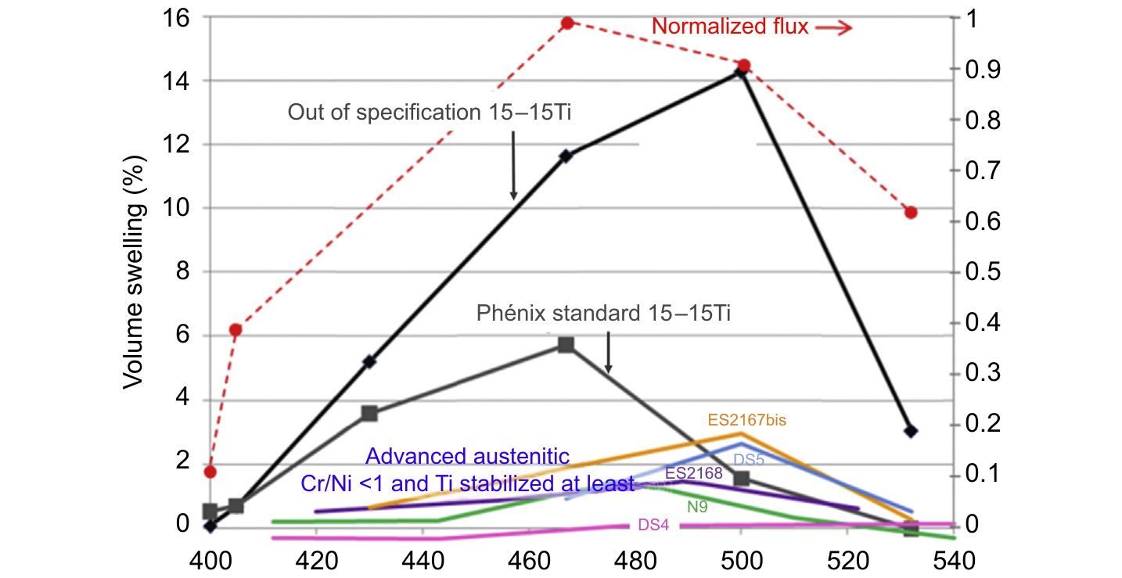
Advanced Austenitic Programs
Precipitation-hardened and high-Ni grades (D21, D25, PE16, Inconel 706) swelled little but lost ductility; abandoned
AIM1 (Europe): 15/15Ti with Si 0.8%, P 0.04%, controlled SR, strict anneal
AIM2 (CEA) target: 130–150 dpa
  Solid-solution 12–15Cr/25Ni, Ti or Ti+Nb stabilized
SUPERNOVA (Phénix, ≤88 dpa): all advanced grades swell less than 15/15Ti
  An out-of-spec 15/15Ti swells most
N9 (AIM2 precursor): far less deformation at 109 dpa, but more hardening and only 12% Cr
Swelling of advanced austenitic grades in the Phénix SUPERNOVA capsule vs. irradiation temperature. Séran & Le Flem, Structural Materials for Gen IV Reactors (2017), Fig. 8.23
Notes:
Sections 8.6.1-8.6.2. Fig. 8.20 (not shown) has the D21/D25/PE16/Inconel 706 ductility data. In Fig. 8.23 the red dashed line is the normalized neutron flux (dpa profile) along the capsule; x-axis is irradiation temperature. DS4 (Ti+Nb) did not swell at all; DS5, similar except N, B and possibly anneal quality, did. N9 (BACCHUS 1, 109 dpa) is promising, but 12% Cr is marginal for nitric-acid reprocessing (Fig. 8.4) and its Ni may be too high for stability. AIM1 post-irradiation data were not yet available when the chapter was written.

Slide 21
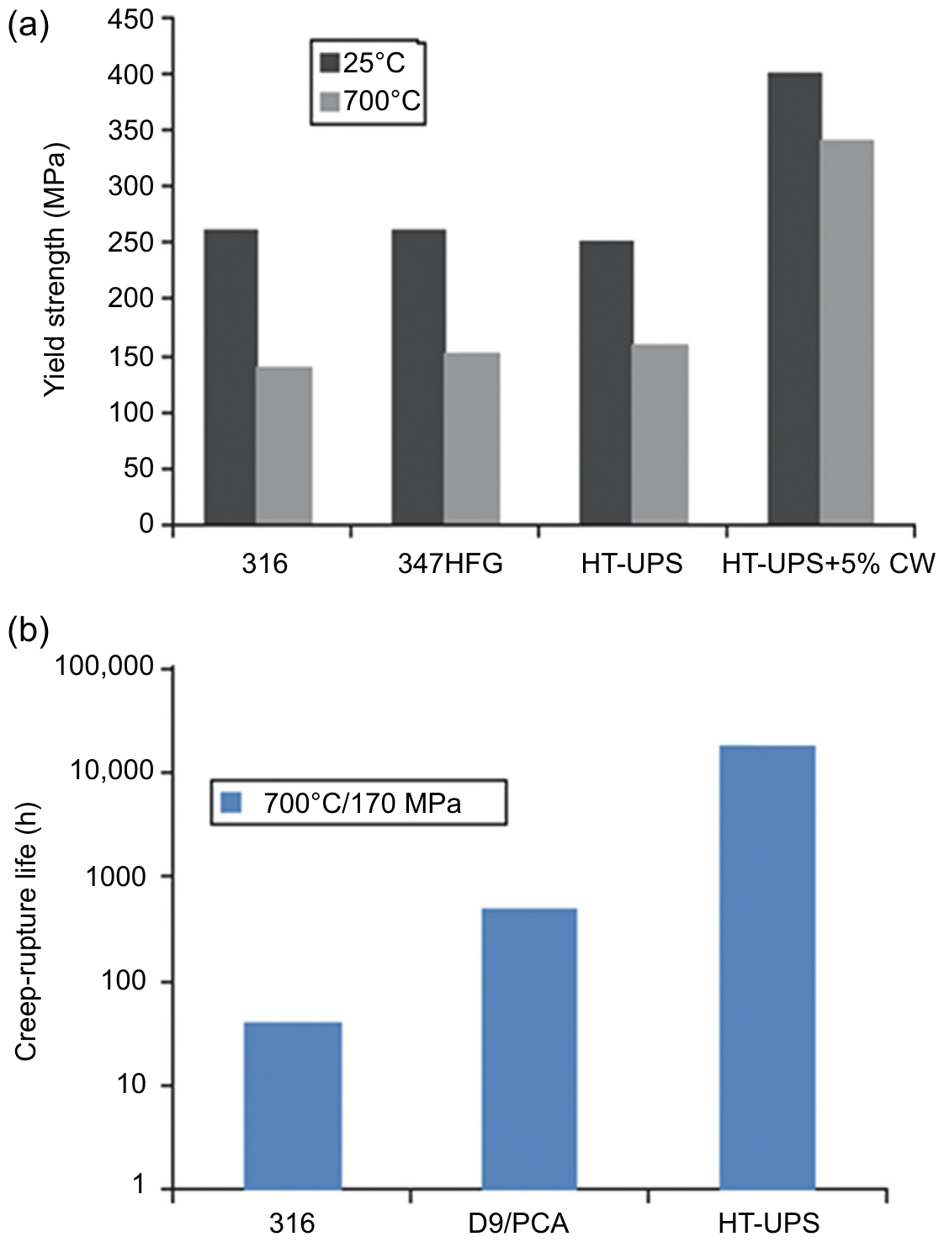
Next-Generation Austenitics
HT-UPS (ORNL): Ti + Nb + V with B and P → stable nanoscale MC carbides
  Orders of magnitude longer creep life than 316 at 700 °C/170 MPa
Alloy 709: SFR structures, not cladding
  Fe–20Cr–25Ni–1.5Mo with Nb and N; ASME III Div. 5 data for 100,000 h completed in 2024
Alumina-forming austenitic (AFA) steels: Pb and LBE coolants
  In Pb at 550 °C, low-Ni AFA resisted; 316L, 15-15Ti and high-Ni AFA did not
(a) Yield strength and (b) creep-rupture life (700 °C/170 MPa) of US austenitic steels. Séran & Le Flem, Structural Materials for Gen IV Reactors (2017), Fig. 8.2, after Maziasz
Other sources: [18]–[21]
Notes:
HT-UPS: Fig. 8.2 is reproduced in the chapter from Maziasz [18]; HT-UPS came from 1970s-80s breeder and fusion work (R&D 100 award, 1990). Alloy 709: Sham and McMurtrey (INL, 2021) [20]; 100,000 h Class A design data completed in 2024, 300,000 and 500,000 h work ongoing (Wang et al. 2025) [21]. RT yield/UTS 270/640 MPa vs. 205/515 MPa for 316H. AFA in Pb: Ejenstam and Szakalos (2015) [19], one year at 550 C, very low O; lowering Ni avoided dissolution attack.

Slide 22
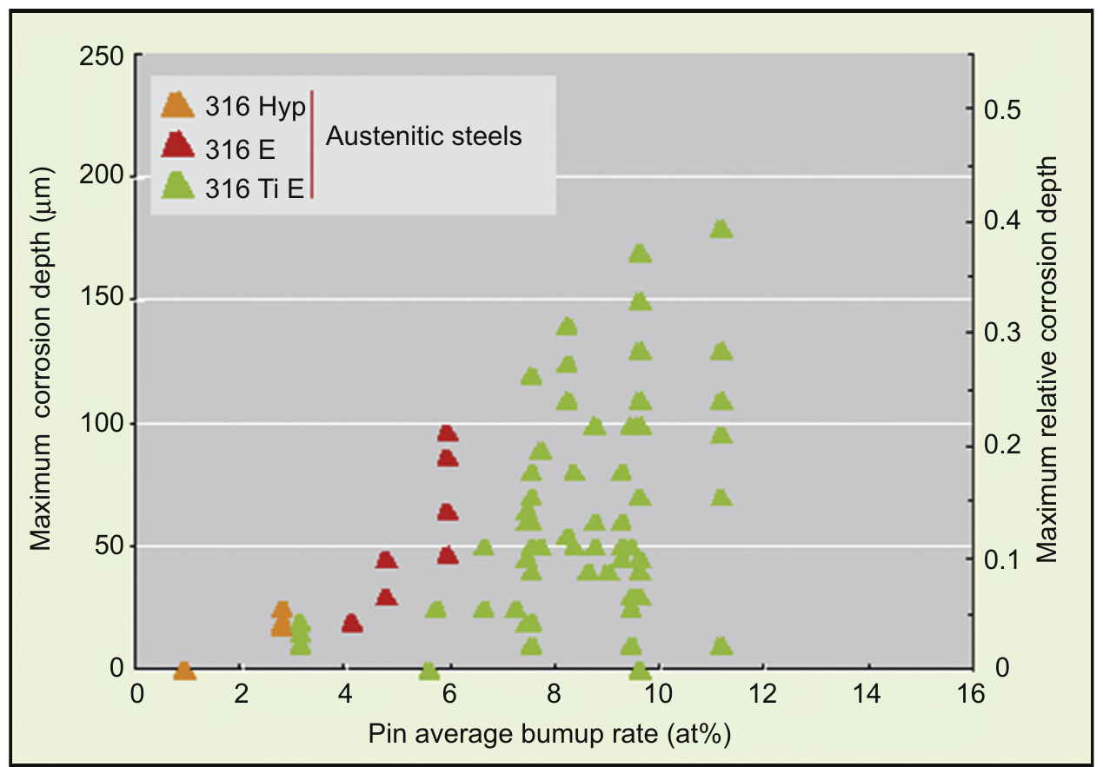
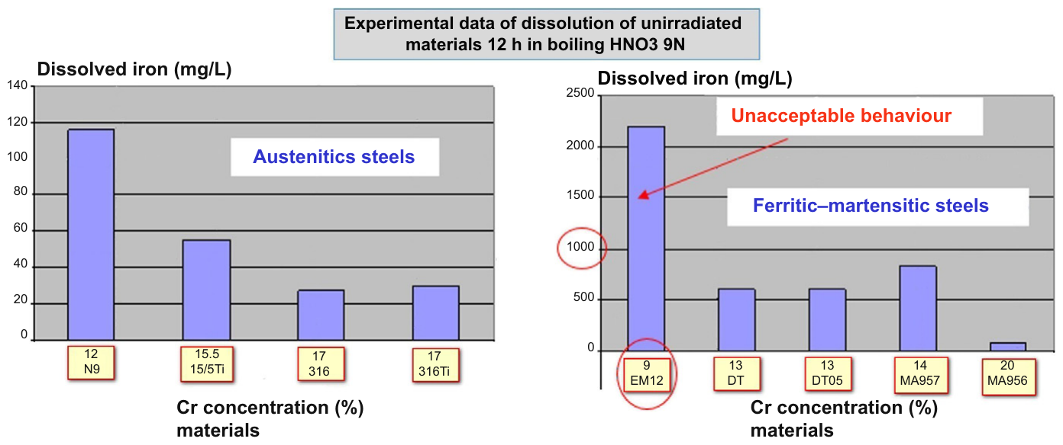
Corrosion and Reprocessing
14–18Cr austenitics are compatible with Na, MOX and nitric acid
Fuel–clad chemical interaction: Te-driven
  Starts above ~5–6% burnup
  Accelerated when swelling and creep open the gap and the fuel runs hotter
Reprocessing: Fe dissolution in boiling HNO₃ is set by Cr content
  316 (~16–17% Cr): no problem; 9Cr EM12: unacceptable
Lower Cr helps swelling but hurts reprocessing (N9 at 12% Cr is marginal)
Top: FCCI depth vs. burnup, Phénix 316-family clads (Fig. 8.3). Bottom: Fe dissolved in boiling 9N HNO₃ vs. Cr (Fig. 8.4). Séran & Le Flem, Structural Materials for Gen IV Reactors (2017)
Notes:
Section 8.3.3. Fig. 8.3: maximum FCCI depth on the first Phénix reference claddings (SA 316, CW 316, CW 316Ti) vs. pin burnup. Fig. 8.4: dissolved Fe after 12 h in boiling 9N HNO3; note the different y-axis scales (austenitics up to ~120 mg/L, EM12 ~2200 mg/L). Compare with the nitric acid data for ODS in the ODS lecture.

Slide 23
Austenitic vs. F/M Summary
 | Advanced austenitic (15/15Ti, D9) | Ferritic-martensitic (HT9, T91, EM10)
Structure | FCC: no DBTT | BCC: DBTT rises under low-T irradiation
Swelling | Incubation, then ~1%/dpa | Very low to ≥150–200 dpa
High-T strength | Higher above ~550 °C | Limited to ~550 °C; ODS compensates
Thermal | ~50% higher expansion, lower conductivity | Lower expansion, higher conductivity
Helium | High Ni → more He | Low Ni → less He
Reprocessing | 16–17% Cr: little dissolution | 9Cr: heavy dissolution
Service record | 15/15Ti to 155 dpa (Phénix) | HT9, EM10 to ~155 dpa
Current role | SFR fuel cladding | Wrappers; ODS for high-dose cladding
Austenitic column: Séran & Le Flem, Structural Materials for Gen IV Reactors (2017), Ch. 8; F/M column: Henry & Maloy, same volume, Ch. 9
Notes:
Good exam prompt: given a coolant, peak cladding temperature and target dose, choose between a Ti-modified austenitic and an F/M or ODS steel, and justify with swelling incubation, DBTT, creep and reprocessing. F/M 155 dpa: HT9 (FFTF) and EM10 (Phénix), Henry & Maloy Table 9.1.

Slide 24
Fe-Cr-al steels

Slide 25
FeCrAl
FeCrAl alloys are expected to have excellent high temperature corrosion behavior and very low void swelling, making them viable candidates for both LWR and advanced reactors
Strong push over the last 10 years to develop FeCrAl after Fukushima, including it as an accident tolerant fuel concept
Alloying additions are weighed to target properties and microstructure
Al allows for formation of Al2O3, limiting high T steam corrosion
Too much Cr leads to sigma phase and alpha’ which cause embrittlement, while too much Al leads to the formation of Al intermetallics
Cr and Al act as bcc stabilizers such that FeCrAl is fully ferritic
Other alloying species are added to increase strength, modify precipitation, etc.

Slide 26
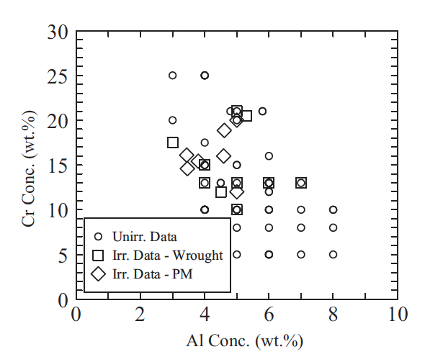
Compositional Limits
A range of alloys have been studied for radiation tolerance utilizing different fabrication techniques
Typically operate from 5-25 wt.%Cr and 2-8wt%Al
If too little Cr/Al is present, get poor high temperature corrosion resistance
To much Cr/Al, embrittlement and fabrication issues
To much of either Cr or Al, unfavorable precipitation behavior
Unirradiated and irradiated compositions studied for FeCrAl alloys for both ingot metallurgy derived and powder metallurgy samples

Slide 27
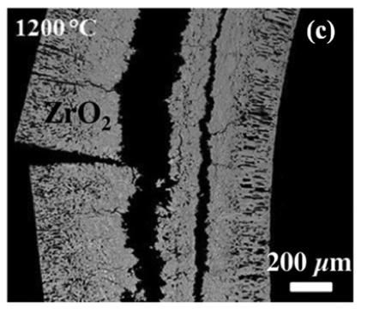
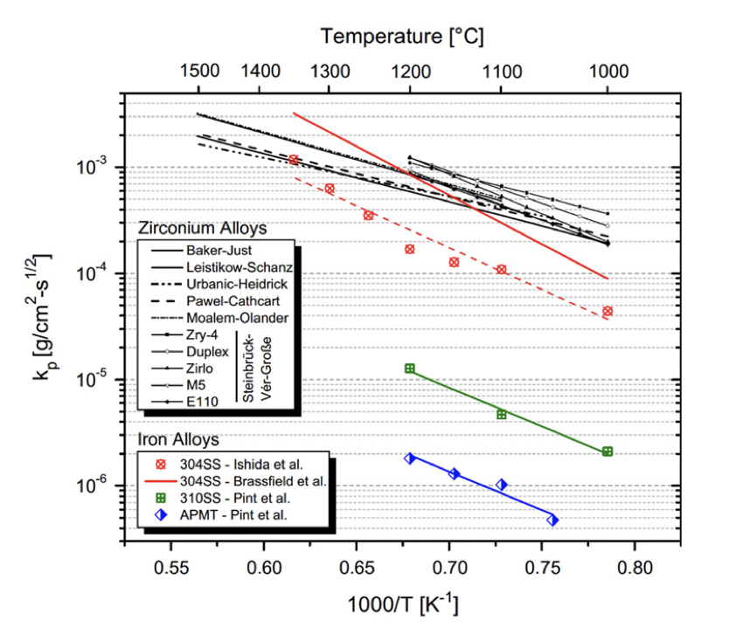
Oxidation Resistance
For applications in LWRs or other water-cooled systems, current cladding (zircaloy) exhibits excessive oxidation at T > 1200 C
FeCrAl can form a stable Al2O3 layer on the surface that is relatively resistant to high temperature steam corrosion
Comparing rate constants of zircaloy, SS, and FeCrAl (APMT), significant oxidation resistance is gained for FeCrAl
Al2O3 is significantly more stable at very high T than either Cr2O3 or ZrO2

Slide 28
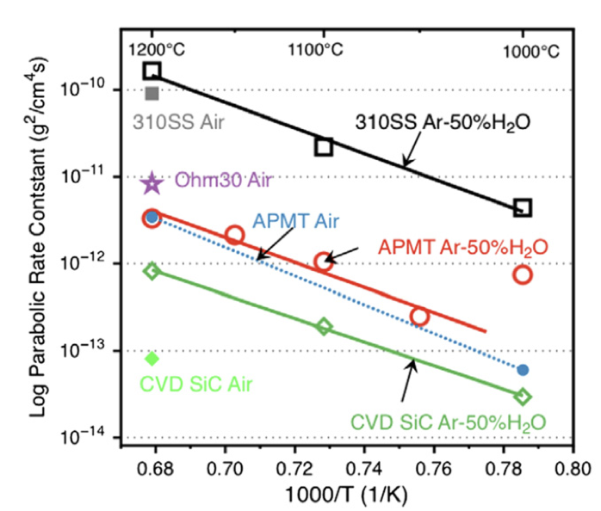
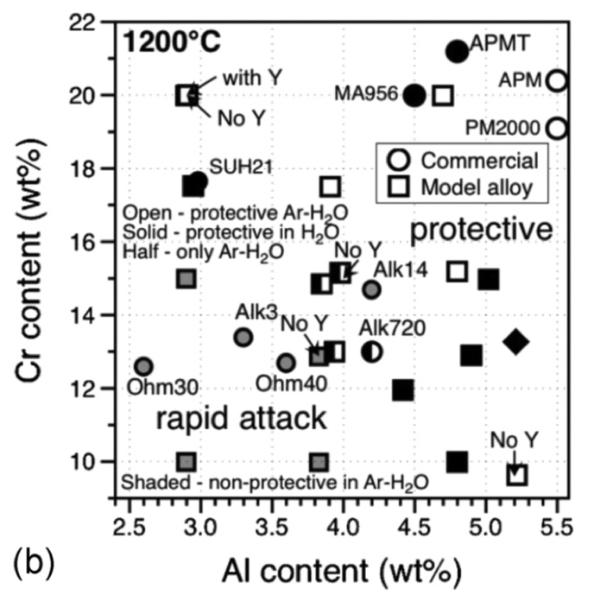
Oxidation Resistance
The composition of the FeCrAl alloy determines its ability to form passivating layers at high T
At a chromium content of 10 wt%, alloys investigated with Al content < 4.5 wt% did not form protective oxide scales
With increasing Cr and Al content, e.g., 12wt% Cr and 4.5 wt% Al, protective scales formed
At ~18 wt% Cr and as low as 3 wt% Al content, a protective oxide can still be formed
This oxidation behavior, in conjunction with irradiation behavior (coming next), determines viable composition ranges of FeCrAl

Slide 29
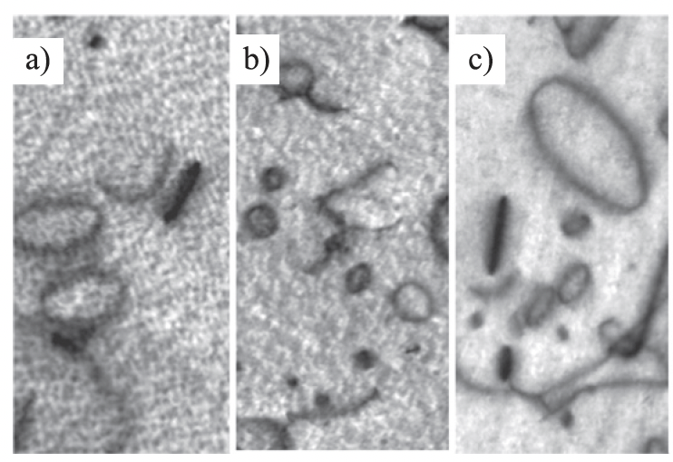
Irradiation Behavior
Effectively no void swelling has been observed up to 23 dpa and 600C
These alloys are expected to display excellent void swelling resistance characteristic of ferritic alloys
Both vacancy and interstitial loops of specific orientations are known to form, regardless of minor compositional variances
Loop size and density are impacted by composition and as-fabricated microstructure

Slide 30
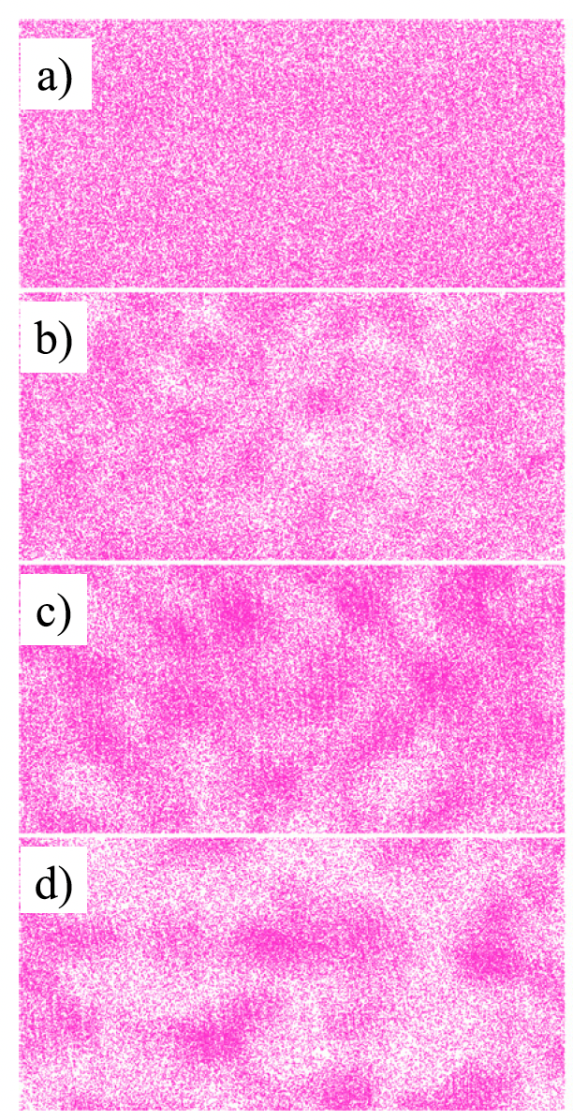
alpha’ Precipitation
Like other high-Cr ferritic alloys, FeCrAl alloys have been shown to be susceptible to irradiation-enhanced precipitation of the Cr-rich alpha’ phase
Embrittlement due to alpha’ formation has a high likelihood of being the primary factor dictating the useful lifetime of FeCrAl components
Aluminum is believed to inhibit, but not prevent, alpha’ precipitation
Irradiation enhanced diffusion accelerates the Cr precipitation, reducing the temperature and Cr-content at which alpha’ is expected to form
Atom probe tomography Cr atom maps during neutron irradiation

Slide 31
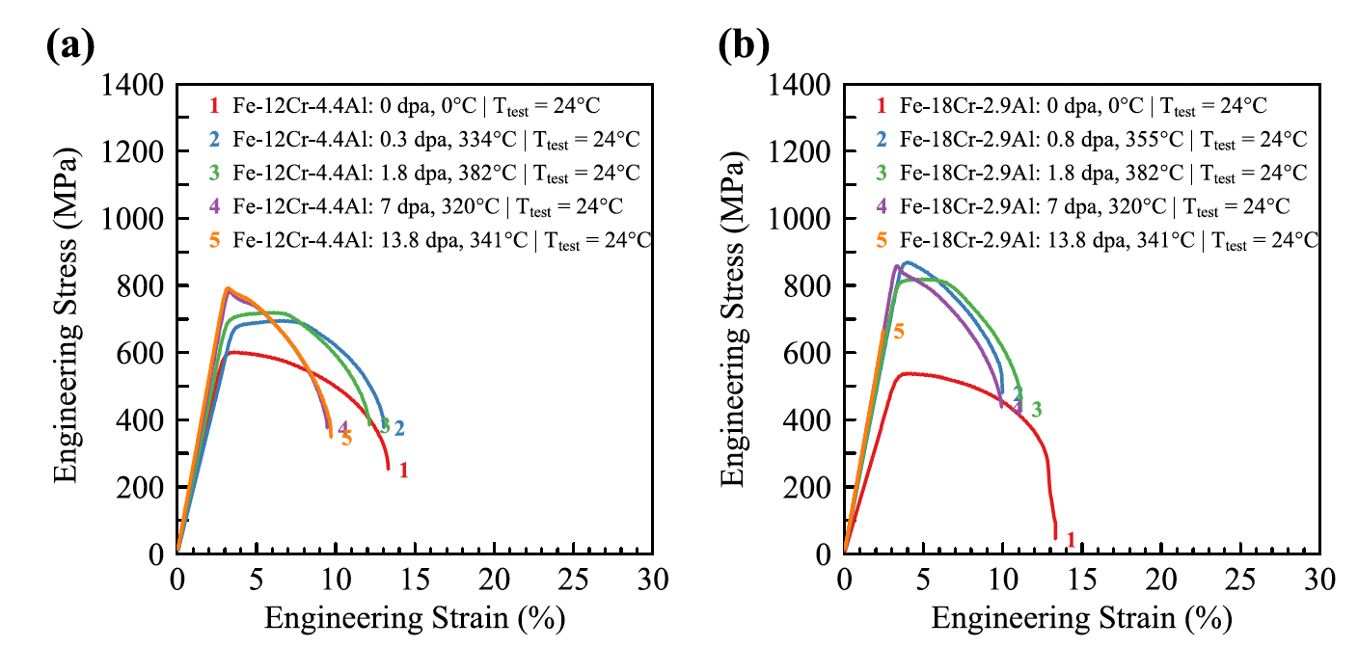
Irradiation Hardening
FeCrAl shows pronounced increases in yield strength and corresponding decreases in total elongation due to dislocations and alpha’ precipitates
The general trend is an initial regime where the yield strength steeply increases with increasing dose and then reaches a saturation
Saturation is typically around 10% elongation
Some high-Cr alloys have shown a third stage of complete embrittlement

Slide 32
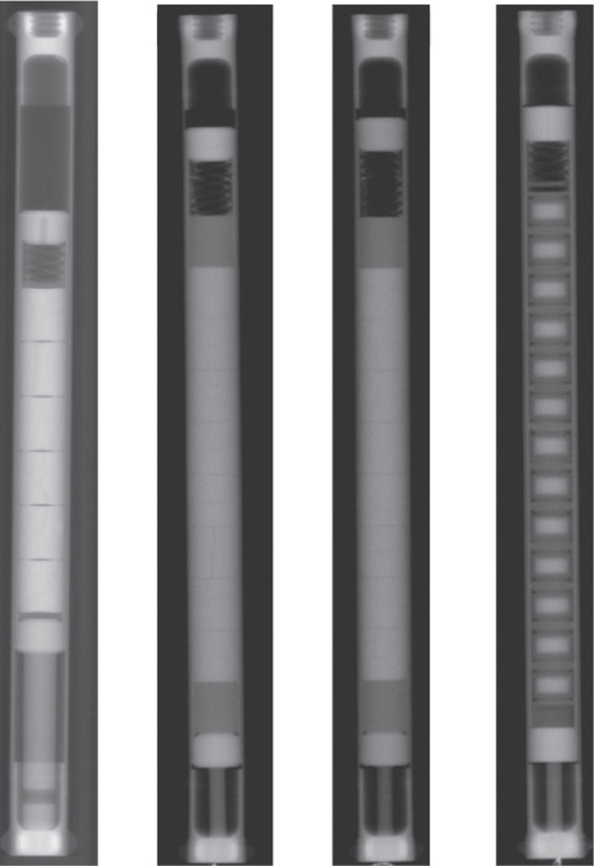
Integral Experiments
FeCrAl is still relatively poorly explored in integral expts
Only a handful of irradiation+corrosion tests; only a handful of fueled cladding tube tests
No major issues identified, but nothing extended to high burnup or transients
So, it is a promising material, but still a long way to go to verify its suitability

Slide 33
ODS Steels

Slide 34
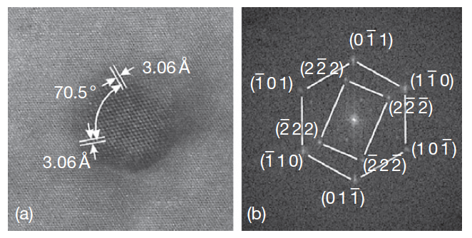
Oxide Dispersion Strengthened Steels
Thermally stable oxide particles dispersed in the ferritic matrix improve the radiation resistance and creep resistance at high temperature
ODS steels have a strong potential for high burnup and high temperature applications typical for SFR fuels
Allow the system to retain essentially a fixed microstructure with irradiation
Typically, Y2O3 particles or Y2Ti2O7 particles
HRTEM of Y2O3 particle with surrounding matrix

Slide 35
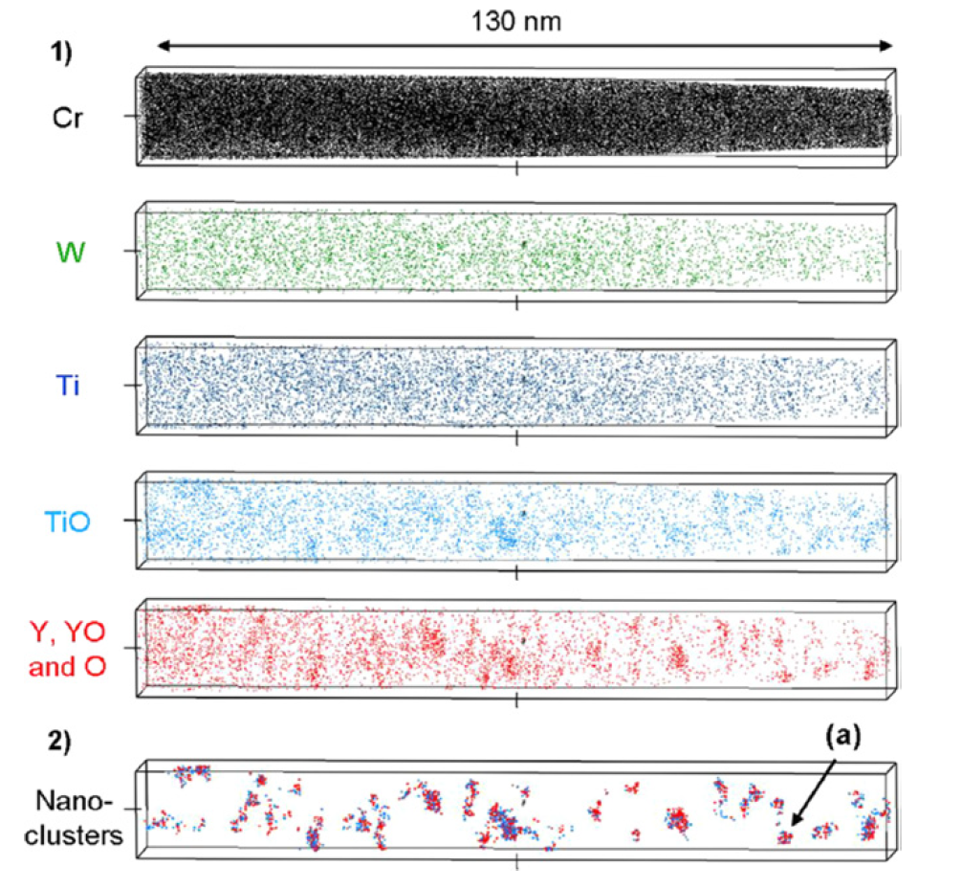
Y2O3 Decomposition
The fine distribution of Y2O3 particles is attained by the dissociation of stable Y2O3 particles which are forced to decompose into the ferritic steel matrix during the mechanical alloying (MA) process
The lattice structure change of Y2O3 in the ODS steel during MA consists of three stages: (1) destruction of the lattice structure, (2) formation of a blurry lattice structure, (3) appearance of amorphous areas
Particles precipitate under heat treatment

Slide 36
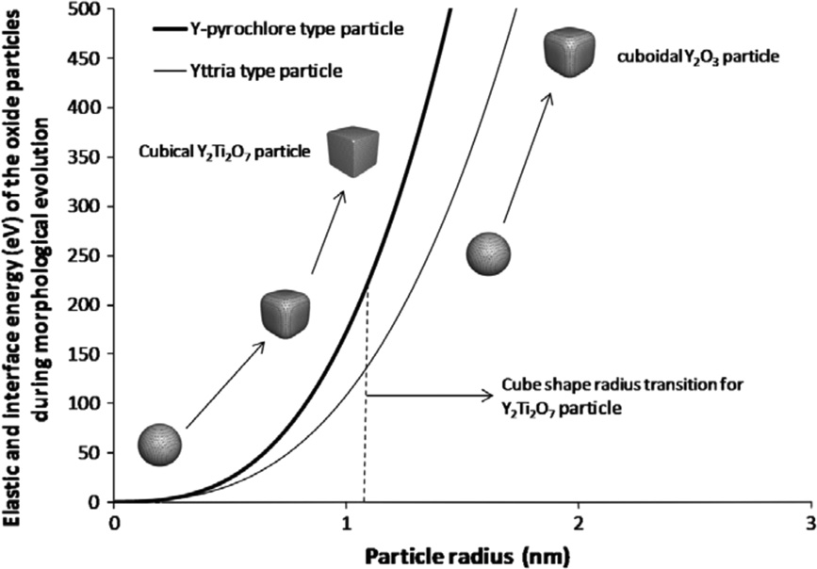
Oxide Particle Structure
The structure of the nanoparticles depend on sintering temperature and time, excess oxygen concentration, etc.
Particles usually evolve from spheroids to cuboids with time/size
Interfacial energy increases with particle size
Misfit strain typically increases with particle size

Slide 37
9Cr-ODS
For nuclear applications, the choice of 9 wt% Cr with a tempered martensitic matrix is preferable to suppress the ductility loss by irradiation hardening and improve the microstructure stability and creep strength at high temperature
The high-temperature strength of 9Cr is drastically improved by nano-scale oxide particles dispersed in the matrix
The standard chemical composition of 9Cr-ODS being developed by the JAEA for SFR application is 9Cr–0.13C–0.2Ti–2W– 0.35Y2O3 (wt%)
The addition of titanium produces the nanoscale dispersion of oxide particles
Tungsten of 2 wt% is also added to improve high-temperature strength via solid solution hardening

Slide 38
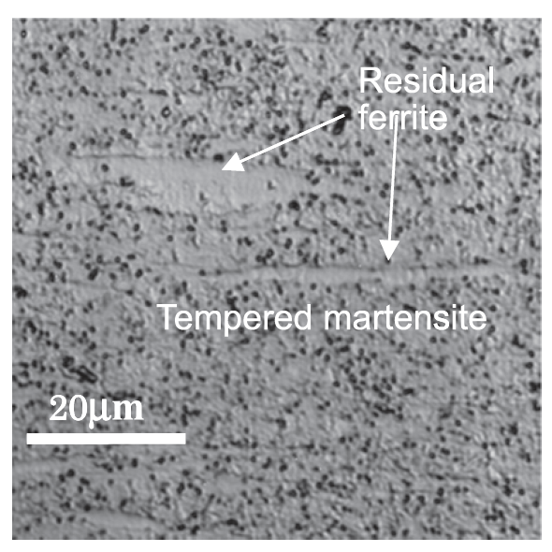
9Cr-ODS microstructure
The microstructure of 9Cr-ODS steel cladding is basically tempered martensite, but includes some residual ferrite phases
Only the full martensite phase can be expected in 9Cr-ferritic steel without yttria under the same conditions
The high temperature strength is greatly improved with the ferrite, and thus control of ferrite is key in ODS fabrication

Slide 39
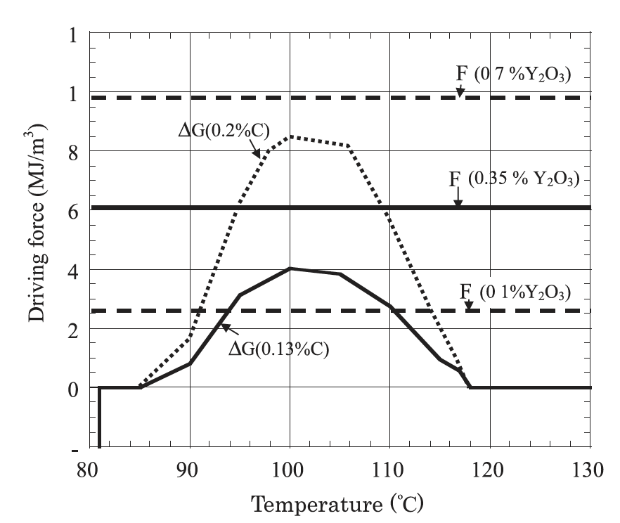
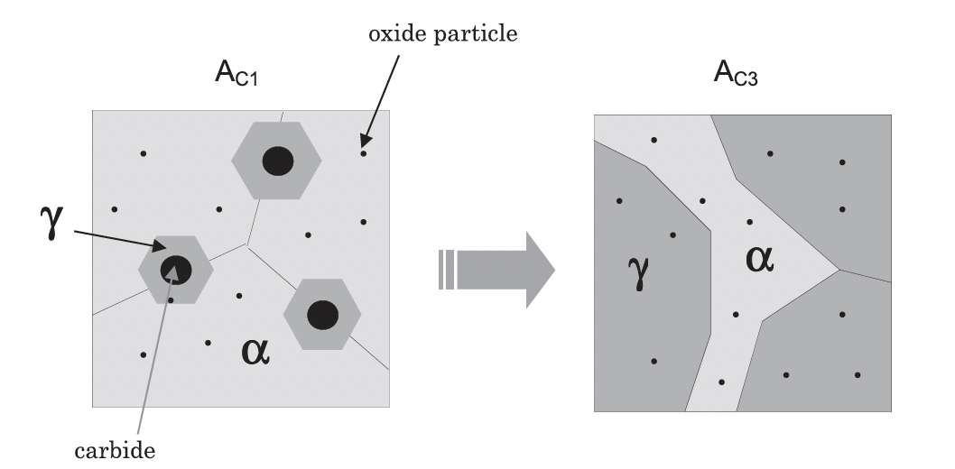
Residual Ferrite
Annealing results in the formation and precipitation of Y–Ti complex oxide particles
This heat treatment should convert ferrite into austenite, but when Y2O3 is present, we retain ferrite at high temperature and through quenching
These oxide particles block the motion of the alpha-gamma interface, there by partly suppressing the reverse transformation from alpha to gamma-phase

Slide 40
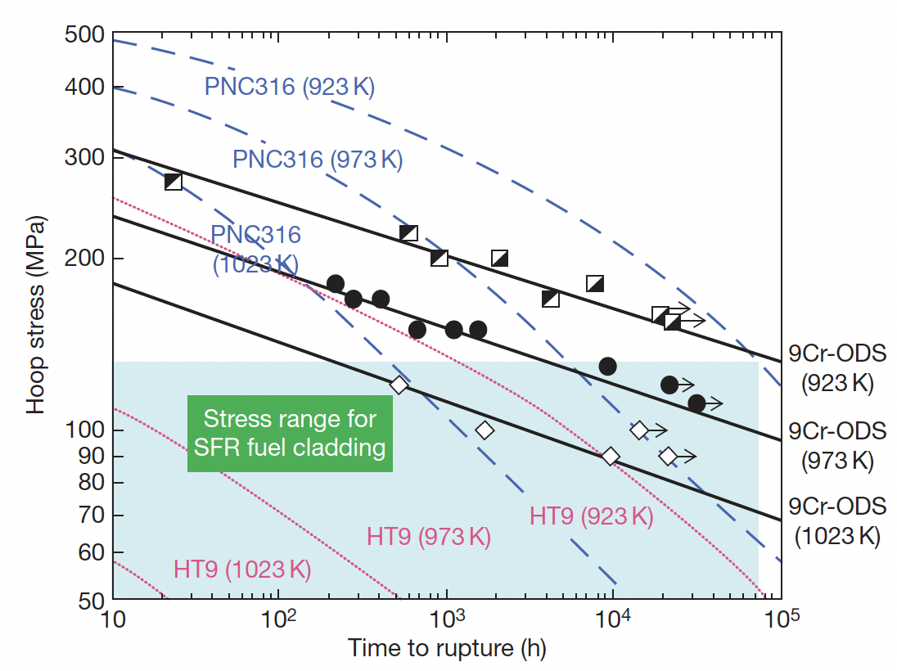
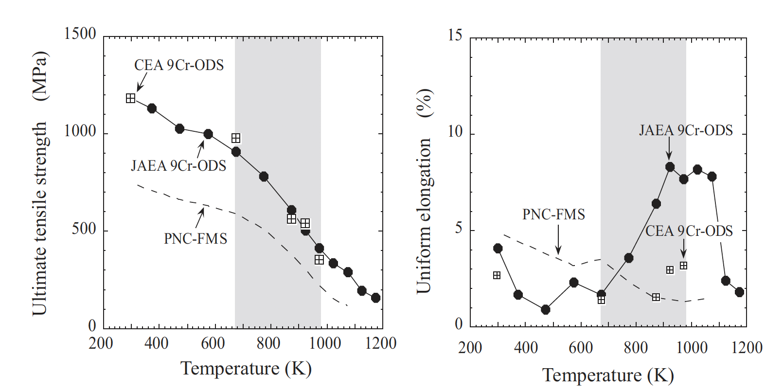
Mechanical Properties
The lifetime of a SFR cladding is mostly determined by the internal creep rupture strength with the internal pressure of the fission gas at a temperature of ~700C
PNC316 is an austenitic steel used developed by JAEA for fast reactors
PNC-FMS is a F/M steel
9Cr-ODS steels have superior creep resistance and higher tensile strength

Slide 41
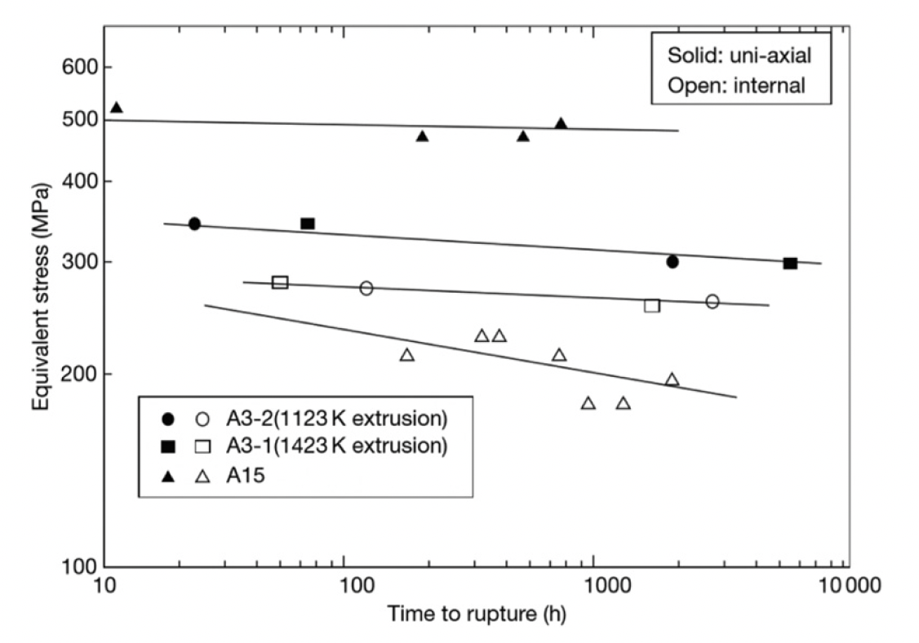
Ferritic 12Cr-ODS Steel
Development of ODS steels began with purely ferritic types, similar to MA957
While these types of steel exhibit excellent creep rupture resistance, there is anisotropy of the rupture strength
Can form elongated grains due to fabrication, weakening cladding in hoop direction
If the Y2O3 content is kept sufficiently low, an equiaxed grain structure can be maintained, providing more isotropic mechanical properties
Creep rupture strength of recrystallized (A3) and unrecrystallized (A15) 12Cr-ODS steels at 650C

Slide 42
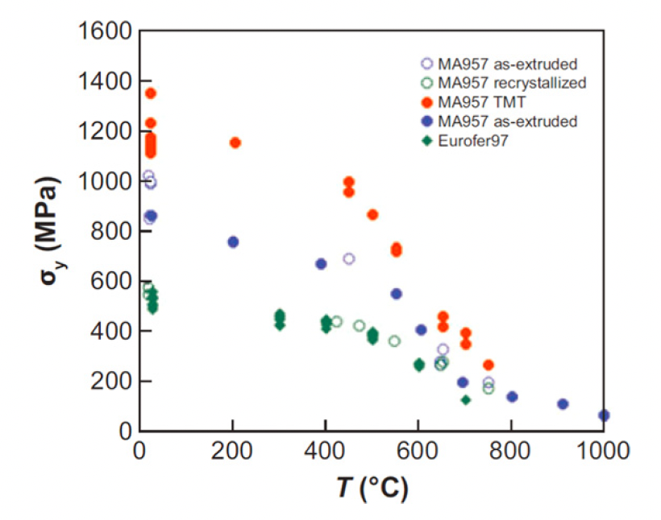
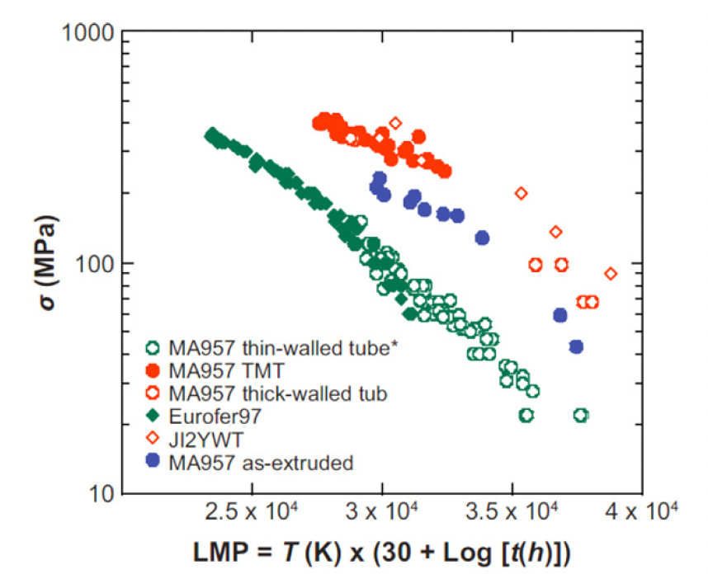
NFAs
Nanostructured ferritic alloys (NFAs) are 12%–20% Cr ferritic stainless steels that are dispersion strengthened by a very high density of ultrafine Y-Ti-O nanofeatures
This high density creates fine grain and dislocation structures
This can yield excellent strength and radiation resistance, but makes fabrication processes very difficult
MA957 is a NFA, Eurofer97 is a tempered martensitic steel

Slide 43
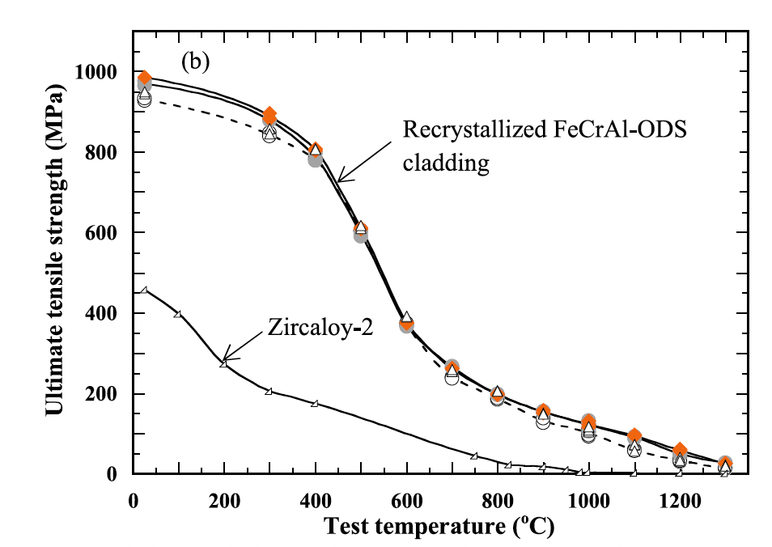
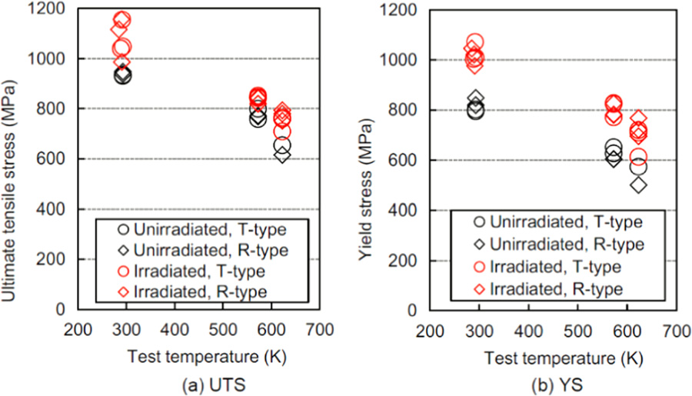
FeCrAl-ODS Steel
FeCrAl steels, with and without ODS are of interest
A nominal composition of Fe-10Cr-6.1Al-0.3Zr (wt%) with 0.3wt% Y2O3 has been studied by ORNL, a number of different alloys explored by JAEA program
Zr is added to prevent ‘large’ Y-Al oxide particle formation
The creep rupture strength of Zr-added FeCrAl-ODS cladding is beyond the existing 9CrODS and 12CrODS steel claddings for fast reactors
T-type (transverse direction) and R-type (rolling direction)

Slide 44
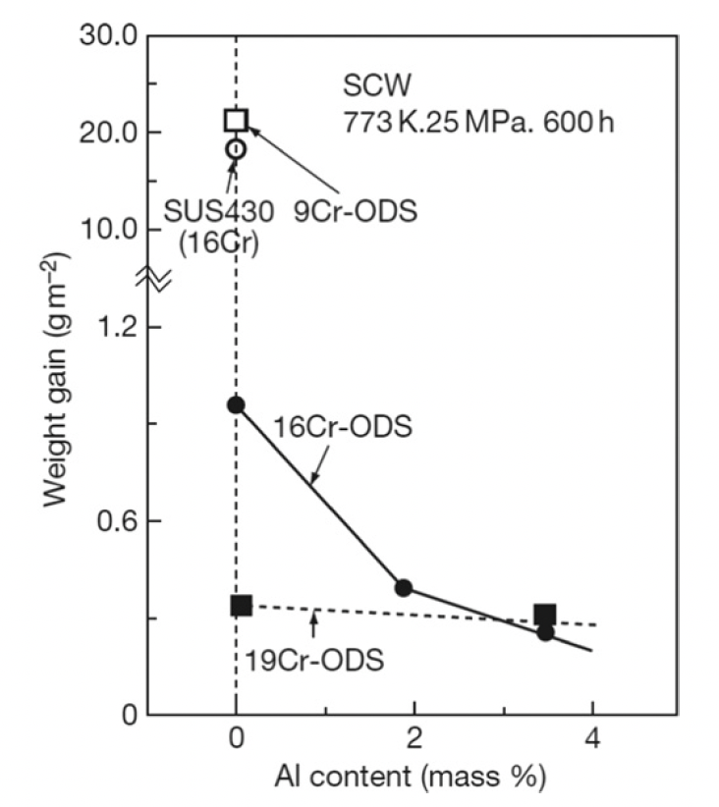
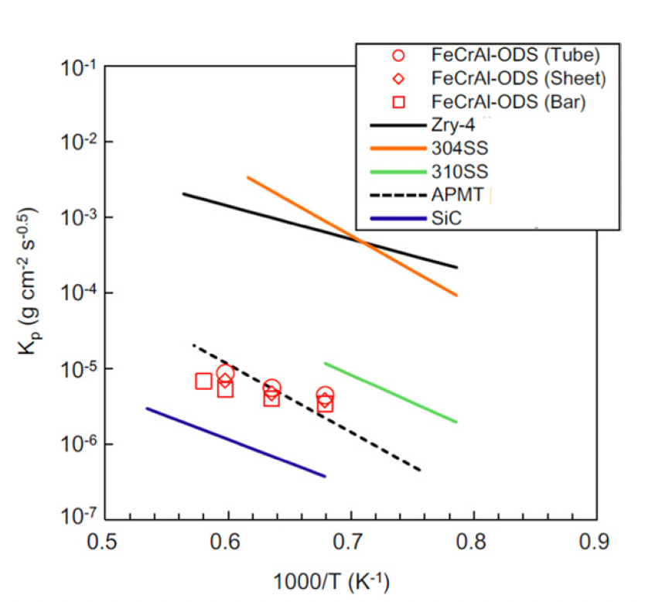
Corrosion
Hot steam oxidation tests are fairly limited in ODS steels
Additional Cr improves corrosion resistance, and Al content greater than 2 wt% provides a protective barrier
Excess oxygen content in the alloys can serve to suppress corrosion
In systems with high amounts of excess oxygen, Zr content can further aid in corrosion resistance

Slide 45
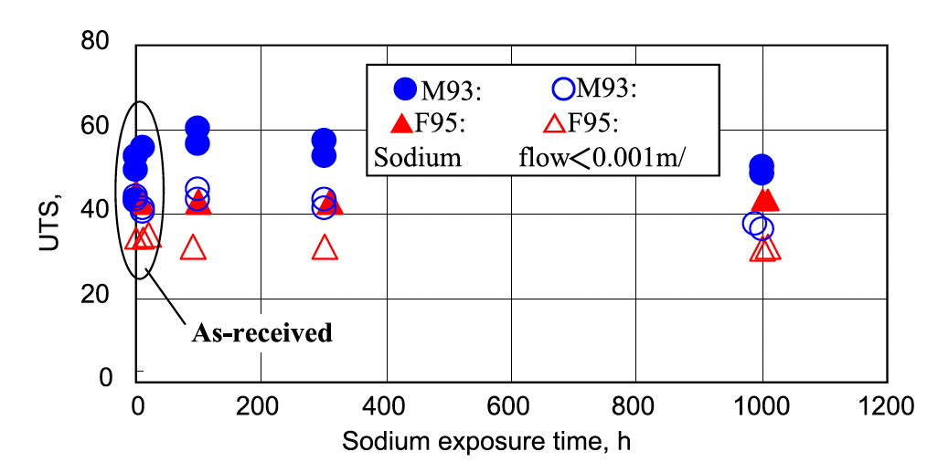
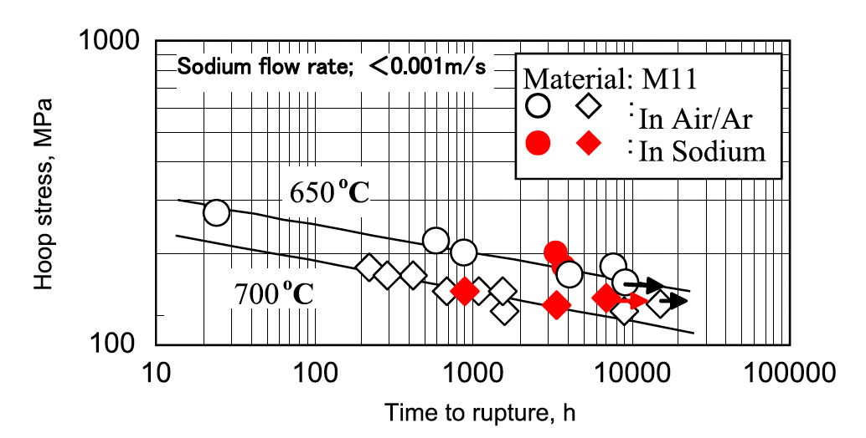
Liquid Na Compatibility
OSD-steels display excellent compatibility with liquid sodium
Both 9Cr and 12Cr ODS steels show no degradation in UTS after prolonged exposure to Na
Creep rupture behavior of ODS steels in air is identical to that in liquid Na
Under irradiation, this corrosion behavior may change, but has not been thoroughly studied

Slide 46
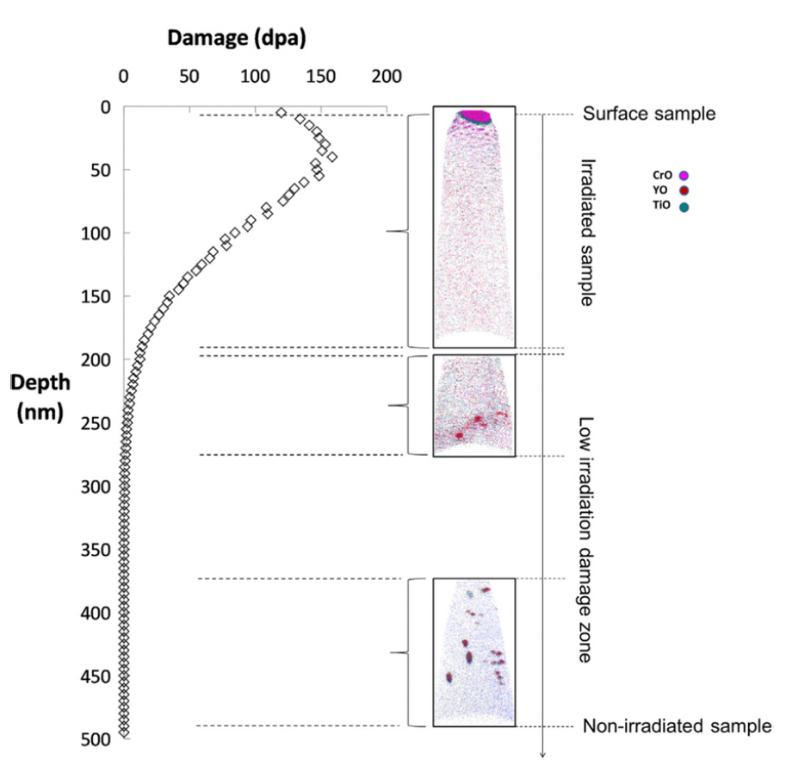
Irradiation Effects
The stability of the oxide particles under irradiation is the key factor in these alloys maintaining their advantageous mechanical properties under operation
Ballistic dissolution-the ejection of atoms from oxide particles due to high energy PKAs and the disordering of the particles-changes the nature of particles under irradiation
Complete dissolution of particles has been observed via APT

Slide 47
Irradiation Effects
At higher temperatures where vacancy diffusion is possible, ballistic dissolution works in conjunction with irradiation-assisted diffusion and changes the oxide particles
The atoms ejected from oxide particles can diffuse back to the original oxide particles, stay in the matrix, or reach other oxide particles
Most studies have reported that the size and number density of the oxide particles hardly change compared to how they were before irradiation
The predominant mechanism of of recovery is the back diffusion to the original oxide particles or re-joining to other existing oxide particles

Slide 48
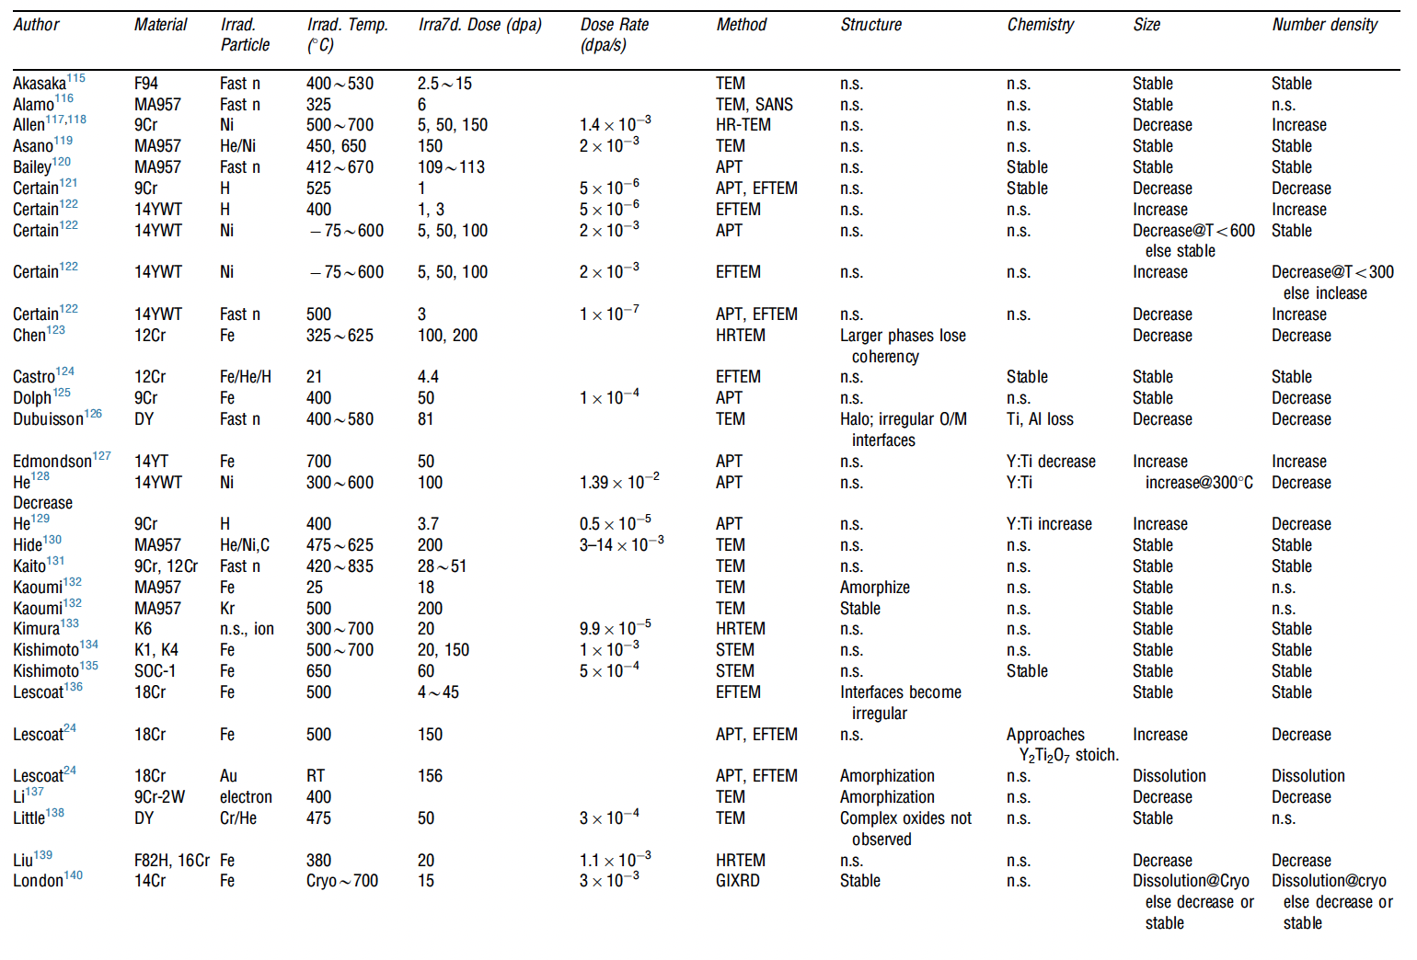
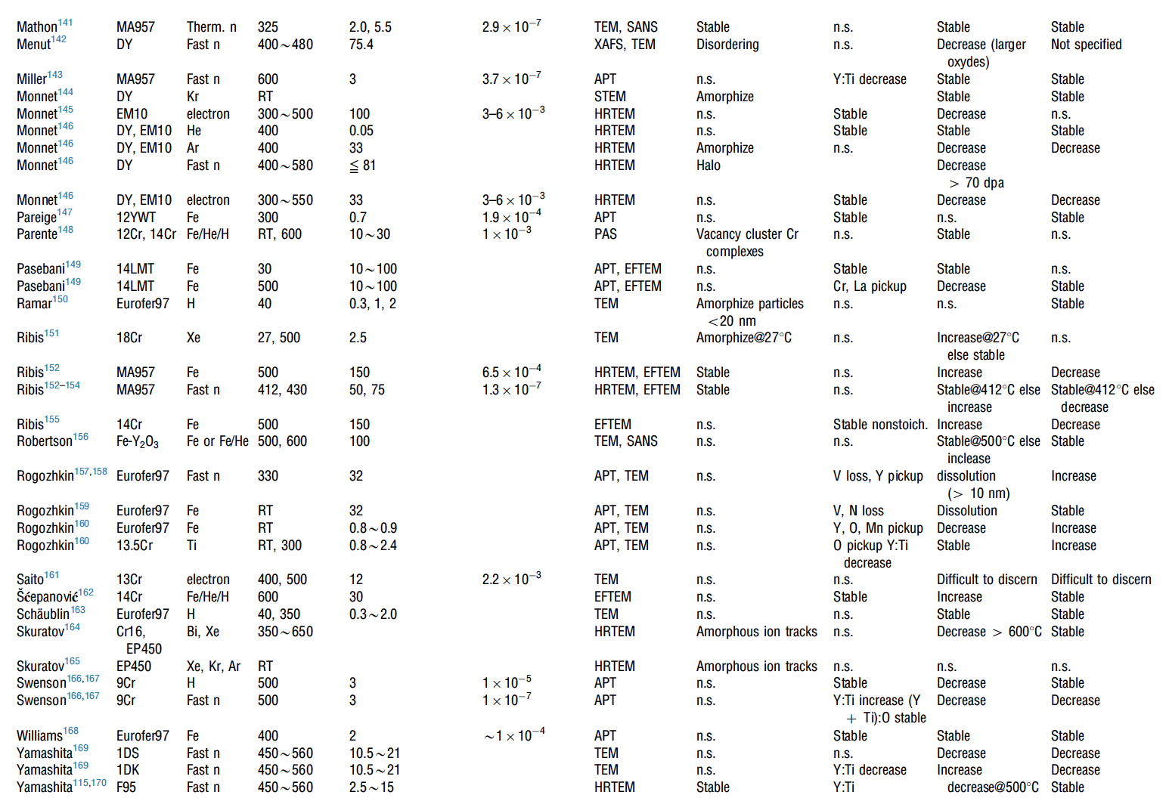
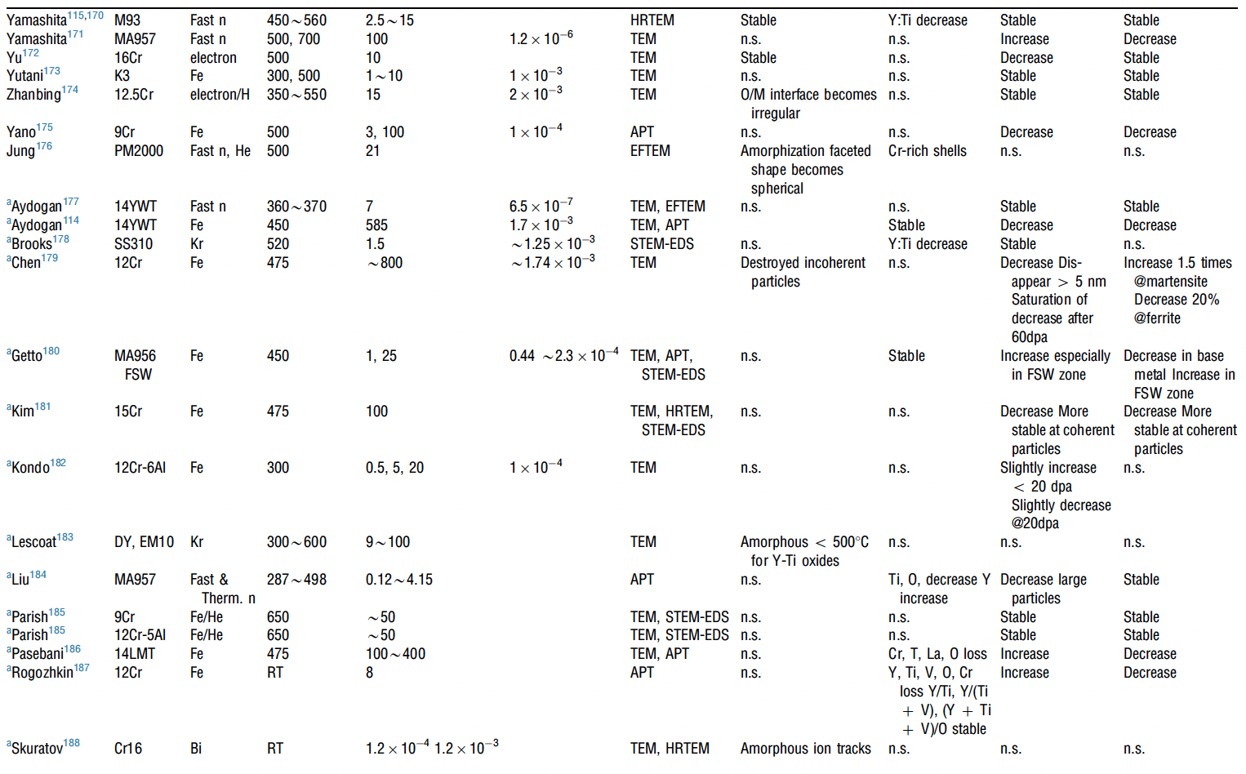
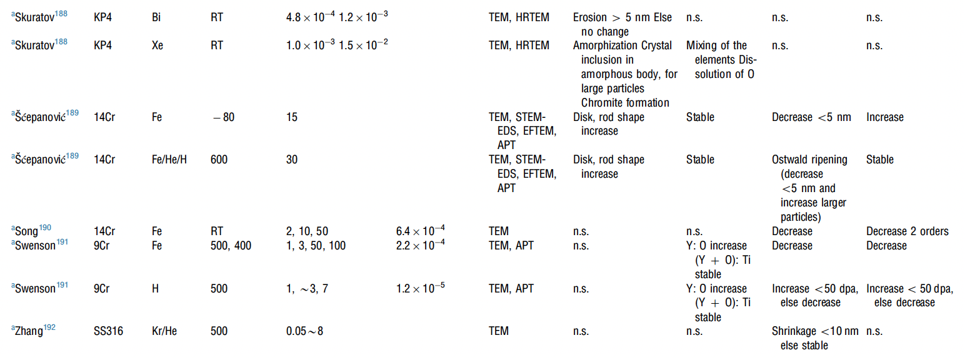
Irradiation Effects
A large number of irradiation experiments have been performed and analyzed to study the evolution of oxide particles
It appears that there is no correlation between irradiation dose, irradiation temperature, and the trend of change in size or number density of oxide particles

Slide 49
Irradiation Effects
Swelling:
  ODS steels are very swelling resistant, as the oxide particles trap vacancies and gas atoms, resulting in very small and homogeneously dispersed voids/bubbles
Hardening:
  hardness increases due to irradiation in ODS steels are smaller than in non-ODS steels
  Oxide particles dominate hardness, and act as sinks for generated point defects

Slide 50
Summary
ODS is fabricated through mechanical alloying and subsequent annealing
9Cr-ODS steel has a unique structure consisting of tempered martensite and residual ferrite that induces superior strength through finely dispersed oxide particles
NFAs have a very high density of oxide particles, producing very high strength and creep resistance, at the cost of workability
FeCrAl-ODS can provide superior corrosion resistance while retaining the ODS influenced mechanical properties
Further in-reactor studies on ODS steels need to be performed
While performance of ODS steels is widely studied, current production is limited to laboratory scale, with prohibitive costs for large scale production

Slide 51
High entropy alloys

Slide 52
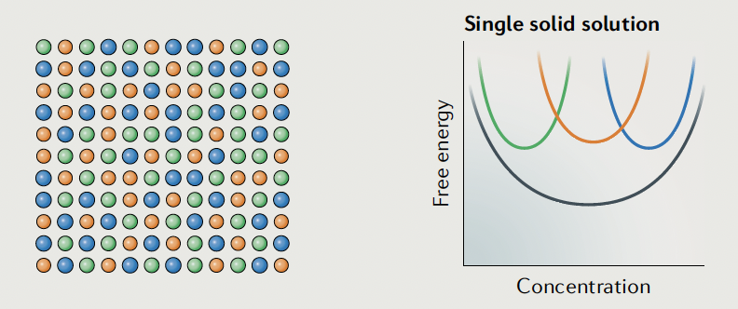
HEAs
The ‘normal’ alloying strategy adds relatively small amounts of secondary elements to a primary element
The combination of multiple principal elements in high concentrations to create new materials yields HEAs
It was theorized that the presence of multiple elements in near-equiatomic proportions would increase the configurational entropy of mixing by an amount sufficient to deter the formation of potentially harmful intermetallics
These can also be called multi-component alloys, compositionally complex alloys and multi-principal-element alloys (some delineations between the groups)

Slide 53
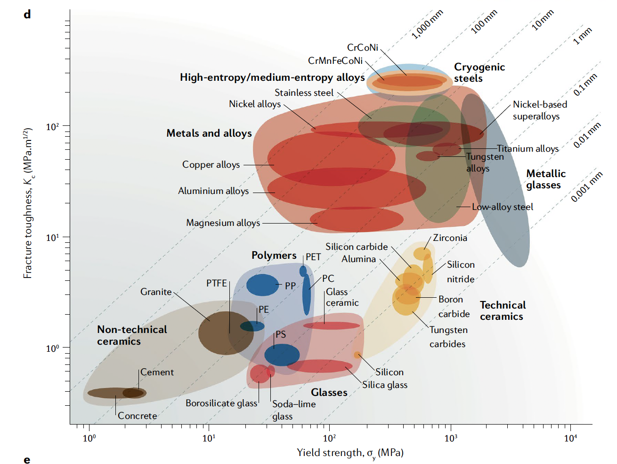
High strength and high ductility
HEAs have numerous appealing properties, such as great strength, great hardness, resistance to corrosion, fracture and fatigue resistance, and high-temperature stability
The concept of solid-solution strengthening is that solute atoms impede the motion of dislocations, increasing the yield strength
In HEAs, there is no single solute, and thus the local disorder/distortion acts as a strong barrier to dislocation motion

Slide 54


HEAs and Radiation Damage
HEAs may also be particularly suitable for high-fluence irradiation applications because of their radiation tolerance
This is related to severe lattice distortions or atomic-level stress caused by mismatches in atom size between the principal elements
This slows diffusion, prevents defect clustering, and promotes recombination
Grain boundaries are natural defect sinks and exist in all materials, but in HEAs the additional compositional complexity increases their efficiency in defect absorption

Slide 55
Notable HEAs
Most studied HEAs are either FCC or BCC based alloys
Cantor alloy: FCC CrMnFeCoNi, this is largely recognized as the first HEA, and can be stabilized as a single-phase FCC
High strength and high ductility that both increase with decreasing temperature
Fractures transgranularly through microvoids
Has been the basis for development of many HEAs, including non-equimolar HEAs with increased twinning-induced plasticity (TWIP)
BCC TiZrHfNbTa alloy
Significantly less is known on BCC HEAs
Comparable high strength to Cantor alloy (yield strength ~1 GPa), but ductility limited to 10-20%
Similar to FCC HEAs, TWIP and TRIP (transformation induced plasticity) are both active and provide ductility

Slide 56

HEAs outlook
This are still very new materials (only 20 years old) and much is still poorly understood, with experimental data scattered
Data for different grain sizes can be contradictory
CALPHAD and DFT are being employed to understand the phase space and the lattice distortion effects, respectively
Fabrication is still a severe challenge, as is cold-working or forming
But… they offer unique potential for high strength, high temperature, and radiation tolerant materials
Mechanical properties of the dual- phase, high- entropy , transformation- induced plasticity alloy Fe50Mn30Co10Cr10

